Slide 1
Course contents
Digital design
Combinatorial circuits: without status
Sequential circuits: with status
FSMD design: hardwired processors
Language based HW design: VHDL

Slide 2
FSMD design
FSMDs
Models
Synthesis techniques

Slide 3
FSMD
FSMD: Finite State Machine with Datapath
FSMD = hardcoded processor
  Consists of a datapath that performs the computations
  and a controller which indicates to the datapath which operations have to be carried out on which data
  The controller always executes the same algorithm: hardcoded
A traditional ASIC consists of multiple interconnected FSMDs

Slide 4
FSMD
Data
inputs
Datapath
Data
outputs
Control
signals
Status
signals
Control
inputs
Controller
Control
outputs

Slide 5
FSMD design
FSMDs
  Datapath design
  Controller design
Models
Synthesis techniques

Slide 6
FSMD design
FSMDs
  Datapath design
  Controller design
Models
Synthesis techniques

Slide 7
Datapath design
Datapath
  Temporary storage: registers, register files, FIFO’s, …
  Functional units: arithmetic and logic units, shifters
  Connections: busses, multiplexors, tri-state bus drivers

Slide 8
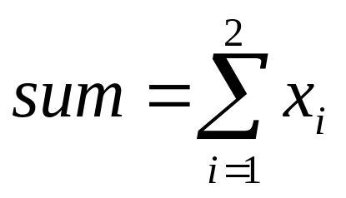
Datapath design
Task:
Algorithm:
Processing
sum = 0
FOR i = 1 TO 2
sum = sum + x_{i}
ENDFOR
y = sum
Control
Datapath construction rules:
  each variable and constant corresponds to a register
  each operator corresponds to a functional unit
  connect outputs of registers to input of functional
  units; when multiple outputs connect to the same input:
  MUX or bus with tristate drivers
  connect output of functional units to input
  of registers; when multiple outputs connect to the same
  input: MUX or bus with tristate drivers

Slide 9
Datapath design
Variables: sum
Algorithm:
Output order:
‘Reset’,’Load’,
’Out’
210
sum = 0
FOR i = 1 TO 2
sum = sum + x_{i}
ENDFOR
y = sum
Operators: add
Connections
x_{i}
Start
0
2
Wait
100
Reset
Register
SUM
Load
Start=1
1
Clk
Add1
010
Add2
010
Add
Output
001
0
y

Slide 10
Datapath design
Task: count the number of ‘1’s in a word
Algorithm:
Data = Inport || OCnt = 0 || Mask = 1
WHILE Data <> 0 DO
Temp = Data AND Mask
OCnt = OCnt + Temp || Data = Data >> 1
ENDWHILE
Outport = OCnt
All instructions on a single line are executed concurrently:
maximum speed, but highest cost
Trading-off speed for area is explained in the section on
‘Synthesis techniques’
All hardware components work in parallel. Implementing
hardware is hence not writing a sequential software
program and implementing this directly in hardware. Above
algorithm is a ‘concurrent’ description!

Slide 11
Datapath design
Data = Inport; OCnt = 0; Mask = 1
WHILE Data <> 0 DO
Temp = Data AND Mask
OCnt = OCnt + Temp; Data = Data >> 1
ENDWHILE
Outport = OCnt
Data = Inport; OCnt = 0; Mask = 1
WHILE Data <> 0 DO
Temp = Data AND Mask
OCnt = OCnt + Temp; Data = Data >> 1
ENDWHILE
Outport = OCnt
Data = Inport; OCnt = 0; Mask = 1
WHILE Data <> 0 DO
Temp = Data AND Mask
OCnt = OCnt + Temp; Data = Data >> 1
ENDWHILE
Outport = OCnt
Data = Inport; OCnt = 0; Mask = 1
WHILE Data <> 0 DO
Temp = Data AND Mask
OCnt = OCnt + Temp; Data = Data >> 1
ENDWHILE
Outport = OCnt
Data = Inport; OCnt = 0; Mask = 1
WHILE Data <> 0 DO
Temp = Data AND Mask
OCnt = OCnt + Temp; Data = Data >> 1
ENDWHILE
Outport = OCnt
Data = Inport; OCnt = 0; Mask = 1
WHILE Data <> 0 DO
Temp = Data AND Mask
OCnt = OCnt + Temp; Data = Data >> 1
ENDWHILE
Outport = OCnt
Data = Inport; OCnt = 0; Mask = 1
WHILE Data <> 0 DO
Temp = Data AND Mask
OCnt = OCnt + Temp; Data = Data >> 1
ENDWHILE
Outport = OCnt
Data = Inport; OCnt = 0; Mask = 1
WHILE Data <> 0 DO
Temp = Data AND Mask
OCnt = OCnt + Temp; Data = Data >> 1
ENDWHILE
Outport = OCnt
Data = Inport; OCnt = 0; Mask = 1
WHILE Data <> 0 DO
Temp = Data AND Mask
OCnt = OCnt + Temp; Data = Data >> 1
ENDWHILE
Outport = OCnt
Data = Inport; OCnt = 0; Mask = 1
WHILE Data <> 0 DO
Temp = Data AND Mask
OCnt = OCnt + Temp; Data = Data >> 1
ENDWHILE
Outport = OCnt
Data = Inport; OCnt = 0; Mask = 1
WHILE Data <> 0 DO
Temp = Data AND Mask
OCnt = OCnt + Temp; Data = Data >> 1
ENDWHILE
Outport = OCnt
Data = Inport; OCnt = 0; Mask = 1
WHILE Data <> 0 DO
Temp = Data AND Mask
OCnt = OCnt + Temp; Data = Data >> 1
ENDWHILE
Outport = OCnt
Data = Inport; OCnt = 0; Mask = 1
WHILE Data <> 0 DO
Temp = Data AND Mask
OCnt = OCnt + Temp; Data = Data >> 1
ENDWHILE
Outport = OCnt
Data = Inport; OCnt = 0; Mask = 1
WHILE Data <> 0 DO
Temp = Data AND Mask
OCnt = OCnt + Temp; Data = Data >> 1
ENDWHILE
Outport = OCnt
Data = Inport; OCnt = 0; Mask = 1
WHILE Data <> 0 DO
Temp = Data AND Mask
OCnt = OCnt + Temp; Data = Data >> 1
ENDWHILE
Outport = OCnt
Data = Inport; OCnt = 0; Mask = 1
WHILE Data <> 0 DO
Temp = Data AND Mask
OCnt = OCnt + Temp; Data = Data >> 1
ENDWHILE
Outport = OCnt
Data = Inport; OCnt = 0; Mask = 1
WHILE Data <> 0 DO
Temp = Data AND Mask
OCnt = OCnt + Temp; Data = Data >> 1
ENDWHILE
Outport = OCnt
Data = Inport; OCnt = 0; Mask = 1
WHILE Data <> 0 DO
Temp = Data AND Mask
OCnt = OCnt + Temp; Data = Data >> 1
ENDWHILE
Outport = OCnt
Data = Inport; OCnt = 0; Mask = 1
WHILE Data <> 0 DO
Temp = Data AND Mask
OCnt = OCnt + Temp; Data = Data >> 1
ENDWHILE
Outport = OCnt
Data = Inport; OCnt = 0; Mask = 1
WHILE Data <> 0 DO
Temp = Data AND Mask
OCnt = OCnt + Temp; Data = Data >> 1
ENDWHILE
Outport = OCnt
Data = Inport; OCnt = 0; Mask = 1
WHILE Data <> 0 DO
Temp = Data AND Mask
OCnt = OCnt + Temp; Data = Data >> 1
ENDWHILE
Outport = OCnt
Data = Inport; OCnt = 0; Mask = 1
WHILE Data <> 0 DO
Temp = Data AND Mask
OCnt = OCnt + Temp; Data = Data >> 1
ENDWHILE
Outport = OCnt
Data = Inport; OCnt = 0; Mask = 1
WHILE Data <> 0 DO
Temp = Data AND Mask
OCnt = OCnt + Temp; Data = Data >> 1
ENDWHILE
Outport = OCnt
Output order:
543210
s=0
Inport
s
Wait
x01x00
s=1
Load
111x00
1
0
5
3
R
Comp
x00000
Data
OCnt
Mask
Temp
4
2
1
z=0
z=1
Temp
x00010
Out
x00001
<>0
AND
Add
>>1
0
Update
010100
zero
Outport

Slide 12
Datapath design
Possible optimisations:
  When the life time of 2 variables is non-overlapping, both can be stored in the same register: register sharing
  When two operations are not executed concurrently, they can be assigned to the same functional unit: functional unit sharing
  When two connections are not used concurrently, they can be shared: connection sharing
  When two registers are not concurrently read from resp. writen to, they can be combined into a single register file: register port sharing
  Operations that could be executed concurrently, may also be executed sequentially, facilitating the four previous optimisations

Slide 13
Datapath design
Generic structure of the datapath:
External input
Temporary storage
Operand switching network
Functional units
Result switching network
External output

Slide 14
Datapath design
Typical datapath:
Inport
S
1
0
WA
WE
RA₁
Register
File
2³
R
RE₁
R
L
Counter
RA₂
Register
C
RE₂
L
COE
RFOE₁
RFOE₂
ROE
Comparator
F
ALU
Sh
Barrel
shifter
D
>
=
<
AOE
SOE
OOE
Outport

Slide 15
Datapath design
In the datapath of previous slide a few decisions have been taken:
  Only 1 i.o. 2 result busses ⇒ ALU and Barrel shifter cannot be used concurrently
  Only 2 i.o. 4 operand busses ⇒ e.g. Compare and ALU work on the same set of data
  9 registers with only 2 write ports and 3 read ports
  Inport can only feed the register file

Slide 16
Datapath design
Instruction format
17
16
15
14
13
12
11
10
9
8
7
6
5
4
3
2
1
0
RA2
RA1
RA0
RE2
RF
OE2
R
L
ROE
F2
F1
F0
AOE
SH2
SH1
SH0
D
SOE
OOE
Register File
Read Port 2
ALU
Barrel
shifter
Register
31
30
29
28
27
26
25
24
23
22
21
20
19
18
R
L
C
COE
S
WA2
WA1
WA0
WE
RA2
RA1
RA0
RE1
RF
OE1
Register
File
Write Port
Register File
Read Port 1
Counter
32-bit instruction word
For reasons of simplicity, clarity and correctness, it is
possible to assign a mnemonic to a certain bit pattern
(e.g. ADD): assembly instruction

Slide 17
Datapath design
The size of the instruction word may be reduced, since several operations cannot be executed concurrently
  Either Register File Read Port 2, either Register Read Port connects to the 1st Operand Bus (-1)
  Either Register File Read Port 1, either Counter Read Port connects to the 2nd Operand Bus (-1)
  ALU & Shift cannot occur concurrently: 1 bit needed to select the operator and 4 bits control the operator (-2)
  When the ALU operator is active, its output may immediately be placed on the result bus; idem for the Barrel shifter (-2)
  For the counter the ‘Count’ and ‘Load’ operations are exclusive (-1)
Additional limitations to concurrency may be introduced at the cost of increased execution time

Slide 18
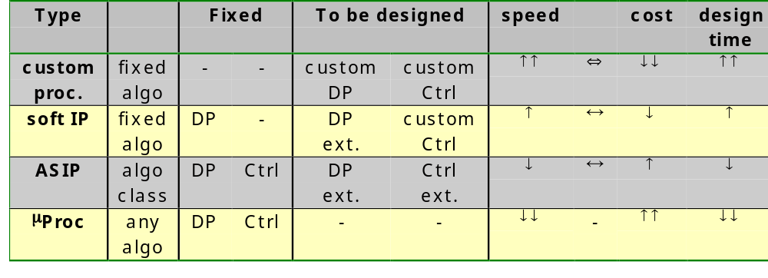
Datapath design
Design freedom
A compiler performs the same tasks as synthesis tools
(e.g. assign variables without overlapping life time to
the same register) but with less degrees of freedom,
since the hardware is fixed

Slide 19
FSMD design
FSMDs
  Datapath design
  Controller design
Models
Synthesis techniques

Slide 20
Controller design
The controller has been designed each time using the design method for FSMs as discussed before
For a large number of states this is a tedious job
Next slides present alternative design methods, that lead to a faster design process in several cases

Slide 21
Controller design
Standard FSM
S*=F(S,I)
Next
State
Combi-
nato-
rial
Logic
D
Q
O=H(S,I)
Output
Combi-
nato-
rial
Logic
Clk
D
Q
Clk
D
Q
Clk

Slide 22
Controller design
Redrawn
Control
Signals (CS)
Status
Signals (SS)
Next
State
CI
SS
Next
state
logic
State
Reg
Control
Input (CI)
Control
Output (CO)
Out-
put
logic
Size State Reg:
⎡log₂n⎤ for n states
for straightforward
and
minimum-bit-change;
n for n states for
one-hot
CS
Current
State
CO
CI
SS

Slide 23
Controller design
Critical path delay:
Find the longest combinatorial path from clock
to clock
Clk→OutStateReg + OutputLogic + AddressToOutRegFile +
BusDriver + BarrelShifter +BusDriver +Mux +
SetupInPortRegFile
1
0
S
1
0
Next
State
S
Next
State
CI
SS
CI
SS
WA
Next
state
logic
WA
Next
state
logic
WE
WE
Register
File
2³
RA₁
Register
File
2³
RA₁
RE₁
R
RE₁
R
R
R
L
Counter
Register
L
Counter
RA₂
Register
State
Reg
RA₂
L
State
Reg
C
RE₂
L
C
RE₂
COE
RFOE₁
RFOE₂
ROE
COE
RFOE₁
RFOE₂
ROE
Out-
put
logic
Out-
put
logic
Barrel
shifter
Comparator
ALU
Sh
Barrel
shifter
CS
Comparator
ALU
Sh
CS
F
F
D
>
=
<
D
Current
State
>
=
<
Current
State
CO
CO
AOE
SOE
AOE
SOE
OOE
CI
SS
OOE
CI
SS
Outport
Outport

Slide 24
Controller design
Modification 1
CS
SS
One-hot
State
reg
CI
Next
State
CI
SS
Next
state
logic
log₂n
→ n
dec.
Properties:
* simple
design and small
next state and
output logic of
one-hot
* small number of
flip-flops of
straightforward
and minimum-
bit-change
State
Reg
CO
Out-
put
logic
CS
Current
State
CO
CI
SS

Slide 25
Controller design
Modification 2
  Often the state diagram shows an unconditional sequence of states, but for a few exceptions
  E.g.
0
Wait
100
Start=1
Add1
010
Add2
010
Output
001

Slide 26
Controller design
Modification 2
CS
SS
Next
State
CI
SS
Next
State
Logic
Next
state
logic
State
Reg
CI
MUX
CO
INC
Out-
put
logic
CS
CO
Current
State
CI
SS

Slide 27
Controller design
Advantage of modification 2:
  The next state logic is very simple:
    for unconditional next state: select the INC
    only for conditional next state the hardware should generate the next state
Implementation of the INC:
  ripple carry chain of Half Adders
  INC and State Reg together form a synchronous counter

Slide 28
Controller design
Modification 3
  Often the state diagram contains a part that is repeated several times ⇒ subroutine
s0
s0
s1
s3
s2
s4
5 states
Only at run-time
it is known
which will be
the next
state following
the end of a
subroutine
⇒ stack
s3
s4
s1
s5
s6
s2
7 states

Slide 29
Controller design
Modification 3
CS
SS
Next State Logic
CI
SS
Next
state
logic
Next
State
Push/
Pop’
State
Reg
Stack
MUX
CI
CO
Out-
put
logic
Return
State
CS
Current
State
CO
CI
SS

Slide 30
Controller design
Combination
CS
SS
CI
SS
Next
state
logic
Next
State
Push/
Pop’
Log₂n
→ n
Dec
Stack
State
Reg
MUX
CI
Out-
put
logic
CO
INC
CS
Current
State
CO
CI
SS
Assumption: Return state = Jump state + 1

Slide 31
Controller design
Implementation of the next state logic and the output logic
  Either construct via Karnaugh a minimal AND-OR implementation
  Either put the truth table in a ROM-table (this method is called microprogrammed control)

Slide 32
Controller design
ROM table
CS
SS
CI
SS
ROM
table
Next
State
Push/
Pop’
Stack
State
Reg
MUX
CI
CO
INC
CS
CO
Current
State

Slide 33
Controller design
Be careful about timing!
Example:
ReadFromExternal(A);
|| sum := 0;
WHILE A <> 1
sum := sum + A;
|| ReadFromExternal(A);
Each iteration of the
WHILE loop (body, test
and decision) should be
executed in just one
clock cycle!!
Comp
A
LA
LS
A
sum
RS
C
Comp
Add
No 3-state drivers: each bus only has one source
C=1 when A<>1

Slide 34
Controller design
Can the controller be state based?
Example:
ReadFromExternal(A);
|| sum := 0;
WHILE A <> 1
sum := sum + A;
|| ReadFromExternal(A);
Animate sequence
A=5,2,1 ⇒ sum=7
Reset is asynchronous
One count too much
sum=8 i.o. 7
7
2
7
1
5
5
8
8
?
?
5
?
5
5
2
1
?
?
LA
LA
LS
LA
LS
LA
LA
LA
LA
LA
LA
LA
LS
LS
LS
LS
LS
LS
LS
LS
s0
LA=1
RS=1
LS=0
s0
LA=1
RS=1
LS=0
s0
LA=1
RS=1
LS=0
s0
LA=1
RS=1
LS=0
s0
LA=1
RS=1
LS=0
s0
LA=1
RS=1
LS=0
s0
LA=1
RS=1
LS=0
s0
LA=1
RS=1
LS=0
s0
LA=1
RS=1
LS=0
s0
LA=1
RS=1
LS=0
A=?
A
A=?
A=5
A=5
A=2
A=2
A=1
A=1
A=?
sum
Sum=?
Sum=0
Sum=0
Sum=0
Sum=5
Sum=5
Sum=7
Sum=7
Sum=8
RS
RS
RS
RS
RS
RS
RS
RS
RS
RS
C=1
C=1
C=1
C=1
C=1
C=1
C=1
C=1
C=1
C=1
s1
LA=1
RS=0
LS=1
s1
LA=1
RS=0
LS=1
s1
LA=1
RS=0
LS=1
s1
LA=1
RS=0
LS=1
s1
LA=1
RS=0
LS=1
s1
LA=1
RS=0
LS=1
s1
LA=1
RS=0
LS=1
s1
LA=1
RS=0
LS=1
s1
LA=1
RS=0
LS=1
s1
LA=1
RS=0
LS=1
Comp
Comp
Comp
Comp
Comp
Comp
Comp
Comp
Comp
Comp
Add
Add
Add
Add
Add
Add
Add
Add
Add
Add
7
7
5
5
8
8
?
?
C=0
?
C=0
C=0
C=0
C=0
C=0
C=0
C=0
C=0
C=0
C=1
C=1
C=1
C=0
C=0
C=?
C=?
C=?
C=1 when A<>1
C=1

Slide 35
Controller design
Can the controller be input based?
Example:
ReadFromExternal(A);
|| sum := 0;
WHILE A <> 1
sum := sum + A;
|| ReadFromExternal(A);
Animate sequence
A=5,2,1 ⇒ sum=7
Reset is asynchronous
Result is correct.
Always check timing!
5
2
1
5
7
5
?
5
2
1
?
?
5
7
8
8
8
LA
?
LA
LA
LA
LA
LA
LA
LS
LS
LS
LS
LS
LA
LS
LA
LA
LS
LS
LS
LS
s0
LA=1
RS=1
LS=0
s0
LA=1
RS=1
LS=0
s0
LA=1
RS=1
LS=0
s0
LA=1
RS=1
LS=0
A=?
A
A=5
A=2
sum
Sum=0
Sum=0
s0
LA=1
RS=1
LS=0
Sum=5
s0
LA=1
RS=1
LS=0
s0
LA=1
RS=1
LS=0
s0
LA=1
RS=1
LS=0
s0
LA=1
RS=1
LS=0
s0
LA=1
RS=1
LS=0
A=5
A=?
A=2
A=1
A=1
A=1
Sum=?
Sum=0
Sum=5
Sum=7
Sum=7
Sum=7
RS
RS
RS
RS
RS
RS
RS
RS
RS
RS
C=1
LA=1
LS=1
C=1
LA=1
LS=1
C=1
LA=1
LS=1
C=1
LA=1
LS=1
C=1
LA=1
LS=1
C=1
LA=1
LS=1
C=1
LA=1
LS=1
C=1
LA=1
LS=1
C=1
LA=1
LS=1
C=1
LA=1
LS=1
s1
RS=0
s1
RS=0
s1
RS=0
s1
RS=0
s1
RS=0
s1
RS=0
s1
RS=0
s1
RS=0
s1
RS=0
s1
RS=0
Comp
Comp
Comp
Comp
Add
Add
Add
Comp
Add
Comp
Comp
Comp
Comp
Comp
Add
Add
Add
Add
Add
Add
C=0
LA=0
LS=0
C=0
LA=0
LS=0
C=0
LA=0
LS=0
C=0
LA=0
LS=0
C=0
LA=0
LS=0
C=0
LA=0
LS=0
C=0
LA=0
LS=0
C=0
LA=0
LS=0
C=0
LA=0
LS=0
C=0
LA=0
LS=0
5
7
?
5
7
8
8
8
?
C=1
C=1 when A<>1
C=1
C=1
C=1
C=0
C=0
C=0
C=?
C=?

Slide 36
FSMD design
FSMDs
Models
  State-action table
  Algorithmic-state-machine chart
Synthesis techniques

Slide 37
FSMD design
FSMDs
Models
  State-action table
  Algorithmic-state-machine chart
Synthesis techniques

Slide 38
State-action table
The specification of an FSMD could be done using the traditional next state & output table
However, for large designs, this becomes not so practical
Next slide shows the next state & output table for the one counting application
Data = Inport; OCnt = 0; Mask = 1
WHILE Data <> 0 DO
Temp = Data AND Mask
OCnt = OCnt + Temp; Data = Data >> 1
ENDWHILE
Outport = OCnt

Slide 39
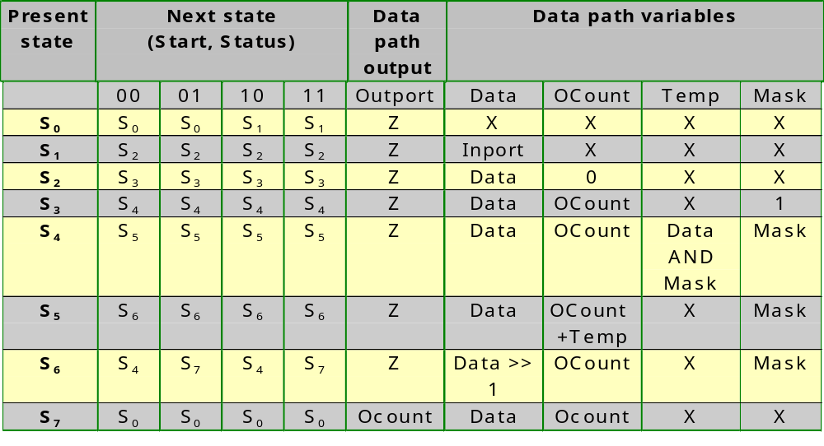
State-action table
Next state and output table

Slide 40
State-action table
The next state and output table do not offer a good overview
  often the next state is only dependent on a few of the inputs
  often, the data path variables do not change
Hence, the same information as in the next state and output table is presented in a more condensed form: the state action table (See next slide)

Slide 41
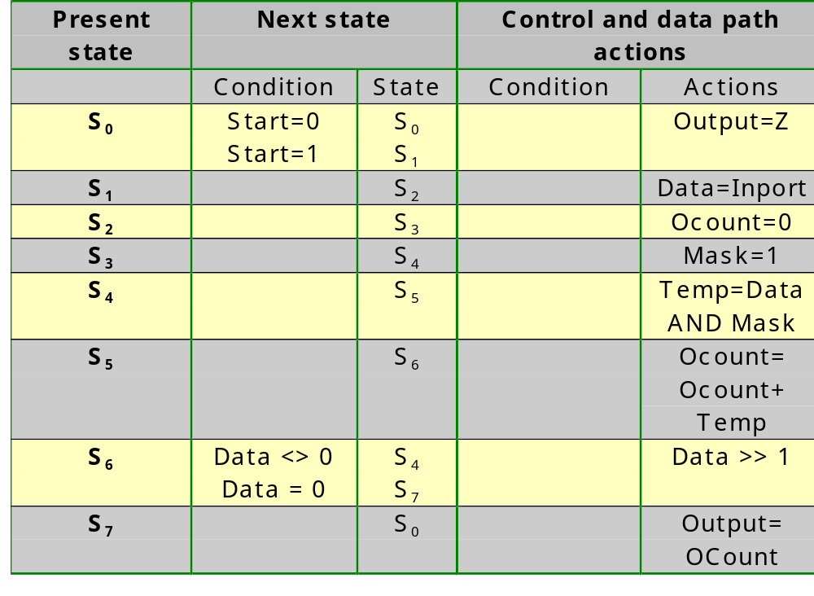
State-action table

Slide 42
FSMD design
FSMDs
Models
  State-action table
  Algorithmic-state-machine chart
Synthesis techniques

Slide 43
Algorithmic-state-machine chart
An algorithmic-state-machine chart (ASM chart) is an alternative visualization method for the state action table
It shows loops, conditions and next states in a way which is easier to understand for a human being
Each row in the state action table translates to an ASM block
ASM blocks are constructed out of three types of elements: state boxes, decision boxes and condition boxes

Slide 44
Algorithmic-state-machine chart
State name
State encoding
Unconditional
variable
assignment
State box
1
Condition
0
Decision box
Conditional
variable
assignment
Condition box

Slide 45
Algorithmic-state-machine chart
Example of an ASM block
s₀
Done = 0
0
Start = 0
1
Data = Inport

Slide 46
Algorithmic-state-machine chart
An ASM block has to obey following rule:
  each input combination should lead to exactly one next state
Example 1 of an invalid ASM block:
s₀
When Cond2=1
there are two
next states
1
Cond1
0
Cond2
0
1
s₁
s₂

Slide 47
Algorithmic-state-machine chart
Example 2 of an invalid ASM block:
When Cond1=0
and Cond2=0
there is no
next state
s₀
1
Cond1
0
0
Cond2
1
s₁
s₂

Slide 48
Algorithmic-state-machine chart
An ASM chart representing a state-based or Moore type FSMD has no condition boxes, since all outputs only depend on the state; all assignments to variables are done in state boxes
An ASM chart representing an input-based or Mealy type FSMD has state boxes as well as condition boxes; variable assignments that only depend on the state are done within the state boxes; variable assignments that depend on input conditions are done in condition boxes

Slide 49
Algorithmic-state-machine chart
s₀
1
Start=1
0
Data=Inport
OCount=0
s₁
s₂
State based (Moore)
0
Data_{LSB}
1
s₃
Ocount=Ocount+1
Data=Data>>1
s₄
1
Data<>0
0
Output=OCount
s₅

Slide 50
Algorithmic-state-machine chart
s₀
1
Start=1
0
Data=Inport
OCount=0
s₁
s₂
Input based (Mealy)
0
Data_{LSB}
1
Only 4 states instead
of the 6 for a state
based approach
Ocount=Ocount+1
1
Data<>0
0
Data=Date>>1
Output=OCount
s₃

Slide 51
FSMD design
FSMDs
Models
Synthesis techniques
  Basic principles
  Merging
    Register sharing (variable merging)
    Functional-unit sharing (operator merging)
    Bus sharing (connection merging)
    Register port sharing (register merging)

Slide 52
FSMD design
FSMDs
Models
Synthesis techniques
  Basic principles
  Merging
    Register sharing (variable merging)
    Functional-unit sharing (operator merging)
    Bus sharing (connection merging)
    Register port sharing (register merging)

Slide 53
Basic synthesis principles
An FSMD represented by an action state table or an ASM chart could be implemented using the methodology we used:
  every variable corresponds to a register
  every operation corresponds to a functional unit
  every reading of a variable correponds to a connection from register to functional unit
  every writing of a variable corresponds to a connection from a functional unit to a register
  every row of the state action table or every ASM block of the ASM chart corresponds to a state of the controller
This method however leads to expensive realisations

Slide 54
Basic synthesis principles
Minimization requires two steps:
  First, the controller can be minimized by
    minimizing the number of states via combining equivalent states
    choosing the best state encoding scheme
    selecting the appropriate flip-flop type
    minimizing the next state and output logic
  Second, the data path should be minimized according to the principles already mentioned:
    When the life time of 2 variables is non-overlapping, both can be stored in the same register: register sharing
    When two operations are not executed concurrently, they can be assigned to the same functional unit: functional unit sharing
    When two connections are not used concurrently, they can be shared: connection sharing
    When two registers are not concurrently read from resp. writen to, they can be combined into a single register file: register port sharing

Slide 55
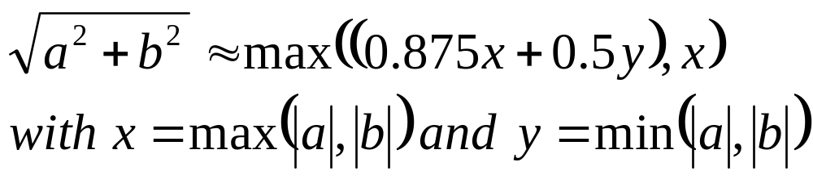
Basic synthesis principles
We are going to show the data path minimizations using an approximation for a square root calculation (SRA: Square Root Approximation):
This approximation could for example be used to compute the power level on a QAM based communication line, in order to detect the start of a packet
  used for CATV communication (cf. Telenet)
  a is then the real part and b the imaginary part of the signal

Slide 56
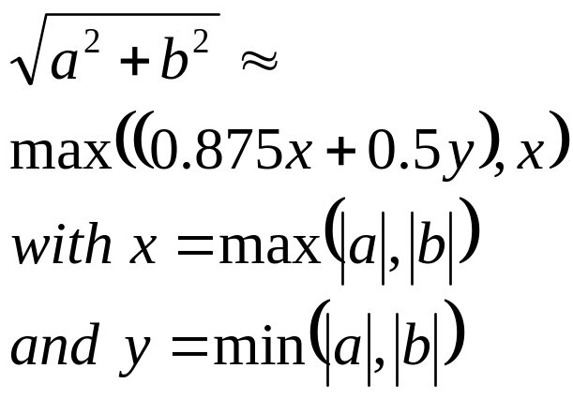
Basic synthesis principles
a=In1
b=In2
0
Start
Out=t7
1
t1=|a|
t2=|b|
t7=max(t6,x)
x=max(t1,t2)
y=min(t1,t2)
t6=t4+t5
t3=x>>3
t4=y>>1
t5=x-t3
t3=0.125x
t4=0.5y
t5=0.875x

Slide 57
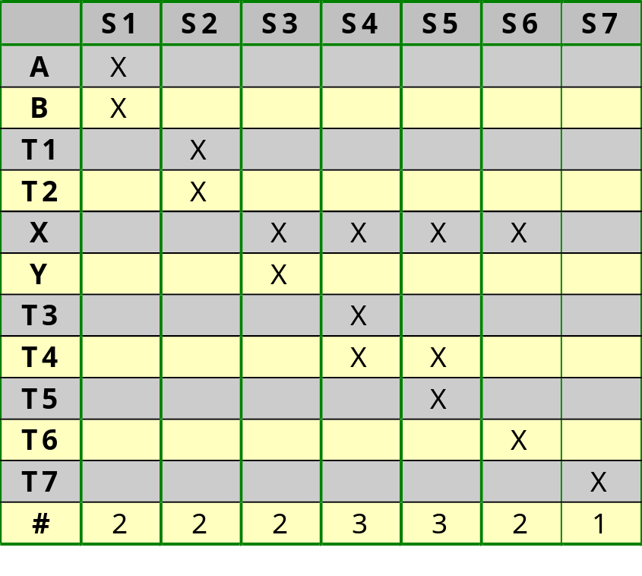
Basic synthesis principles
Liveliness of variables:
a variable is alive in first
state following active
clock edge which assigns
its new value
a=In1
b=In2
and in all states between
this first state and the
last state which uses it.
0
Start
Out=t7
1
t1=|a|
t2=|b|
t7=max(t6,x)
x=max(t1,t2)
y=min(t1,t2)
t6=t4+t5
t3=x>>3
t4=y>>1
t5=x-t3

Slide 58
Basic synthesis principles
We see that at most 3 variables are life at the same time
We hence should try to map all variables to three registers in such a way that their lifetimes do not overlap
In a further section, the algorithm is presented to accomplish this: register/memory sharing

Slide 59
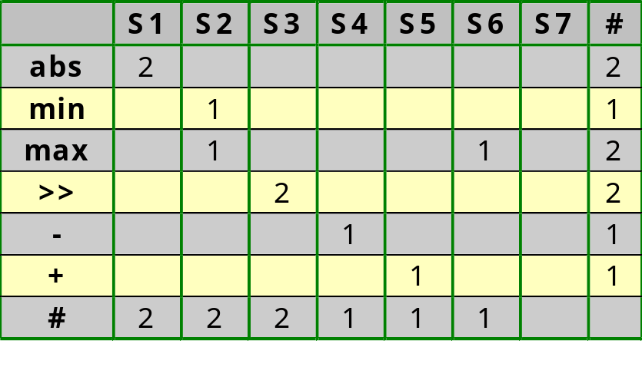
Basic synthesis principles
Operation usage:
a=In1
b=In2
0
Start
Out=t7
1
t1=|a|
t2=|b|
t7=max(t6,x)
x=max(t1,t2)
y=min(t1,t2)
t6=t4+t5
t3=x>>3
t4=y>>1
t5=x-t3

Slide 60
Basic synthesis principles
The straightforward approach would allocate 2 abs, 1 min, 2 max, 2 shift, 1 subtractor and 1 adder components, i.e. 9 components
However, at most 2 are active at the same time
We should hence try to merge multiple functions into one component: e.g. the subtractor and adder together
In a further section, the algorithm is presented to accomplish this: functional unit sharing

Slide 61
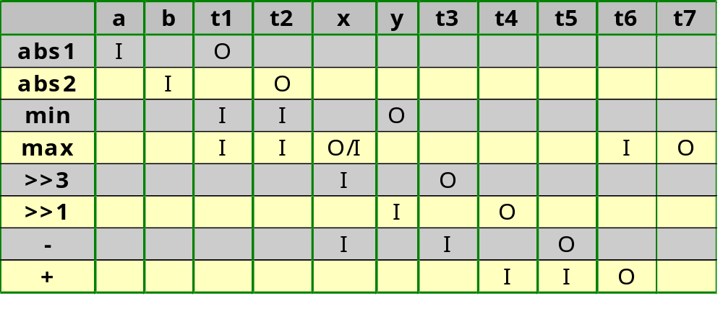
Basic synthesis principles
a=In1
b=In2
0
Start
Out=t7
1
t1=|a|
t2=|b|
t7=max(t6,x)
x=max(t1,t2)
y=min(t1,t2)
t6=t4+t5
t3=x>>3
t4=y>>1
t5=x-t3
Connectivity table:

Slide 62
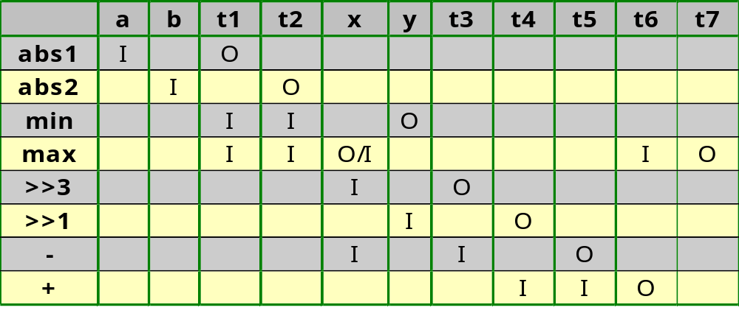
Basic synthesis principles
The straightforward approach would allocate 20 connections (11 register outputs and 9 FU outputs)
In state S2, the largest number of connections is needed: 4 inputs and 2 outputs.
We should hence try to merge multiple connections into one bus
In a further section, the algorithm is presented to accomplish this: connection merging

Slide 63
FSMD design
FSMDs
Models
Synthesis techniques
  Basic principles
  Merging
    Register sharing (variable merging)
    Functional-unit sharing (operator merging)
    Bus sharing (connection merging)
    Register port sharing (register merging)

Slide 64
Register sharing
Definition of the lifetime of a variable:
  The set of states in which the variable is alive
  starting at the state following the state in which it is assigned a new value (write state)
  ending at every state in which its value is used (read state)
  and all the states on each path between the write state and a read state.
  Note that a variable may be written more than once (multiple assignments)
  and that a single written value may be read multiple times.
After determining the lifetime of the variables, we have to group variables with non-overlapping lifetimes and assign each group to a single variable. We should hence find the smallest number of groups.

Slide 65
Register sharing
Determine variable
lifetimes
Sort by write state
& life length
Allocate new
register
Left-edge algorithm
Assign to reg. all
non-overlapping
variables top down
Remove all
assigned variables
from list
no
Empty?
yes

Slide 66
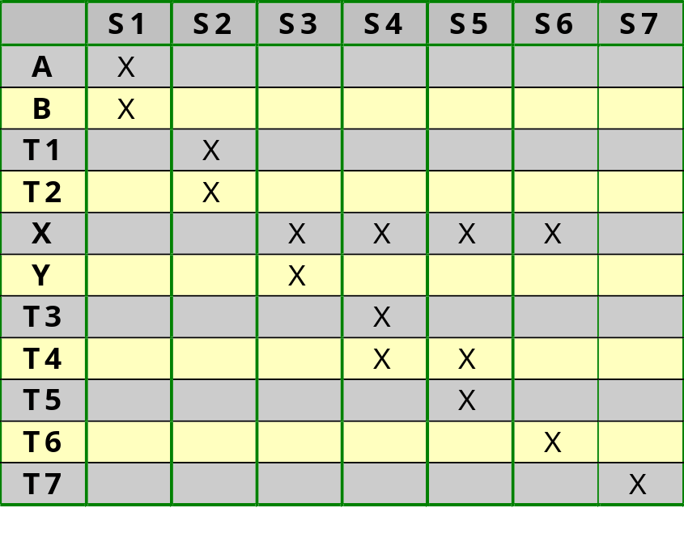
Register sharing
Determine variable lifetimes

Slide 67
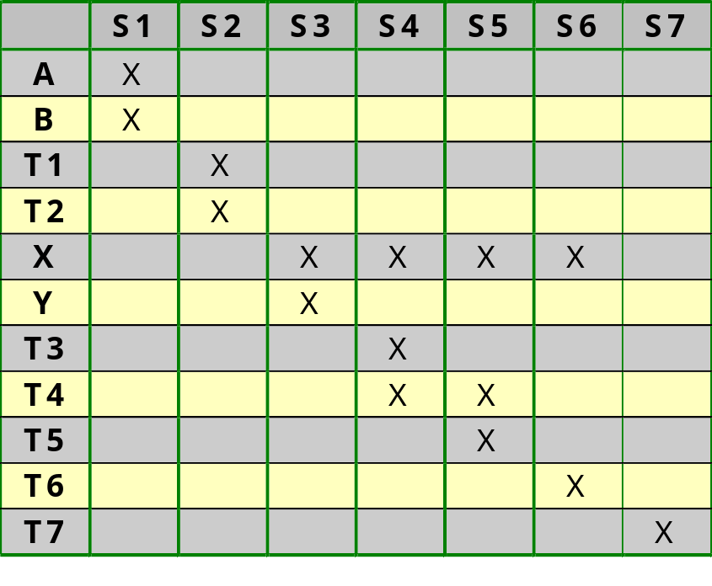
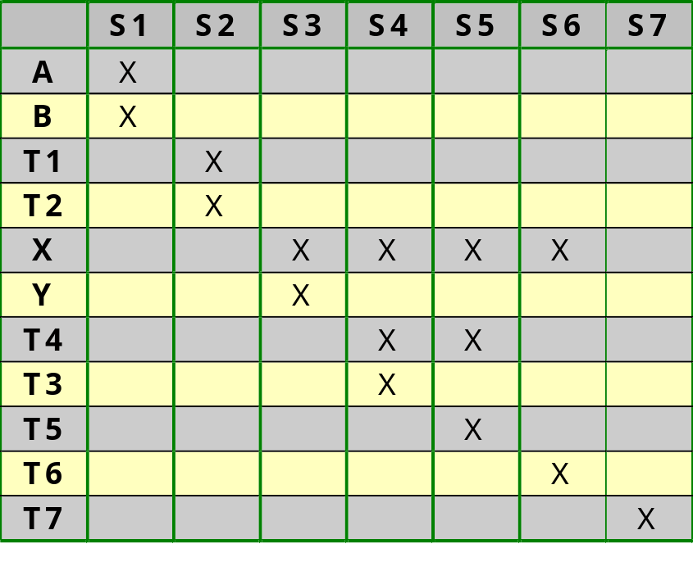
Register sharing
Sort variables by write state and lifetime
T4 has longer lifetime
than T3

Slide 68
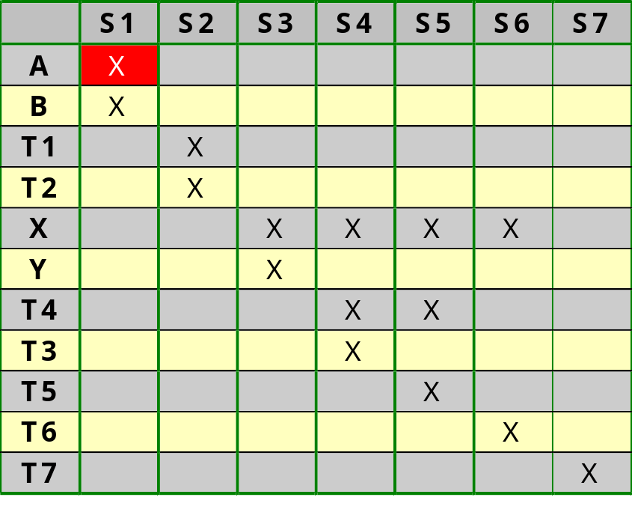
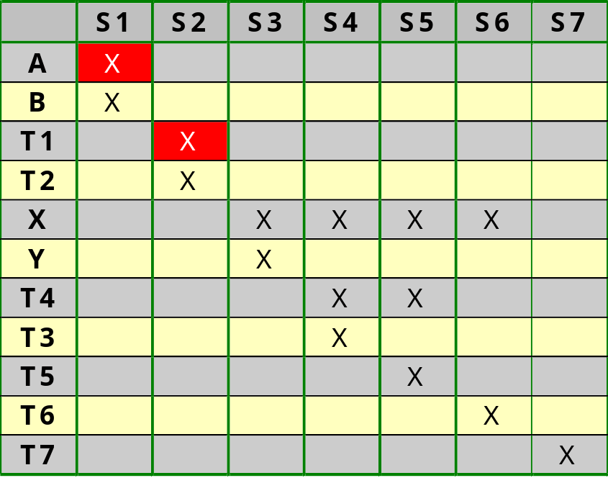
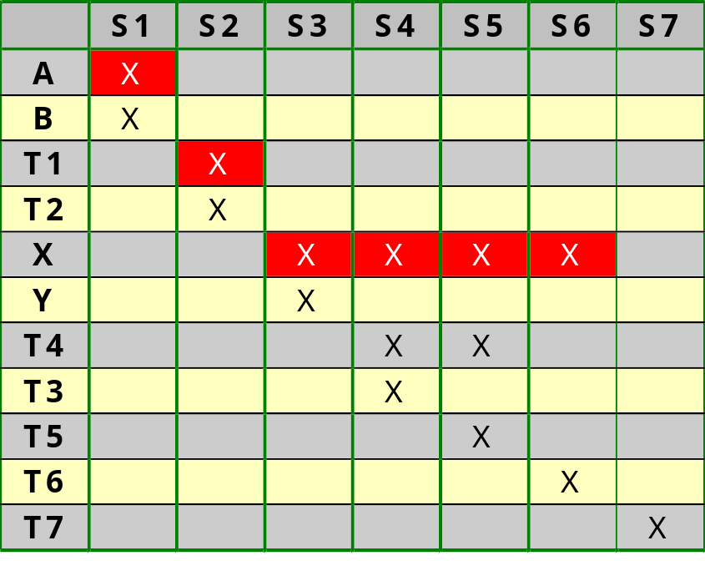
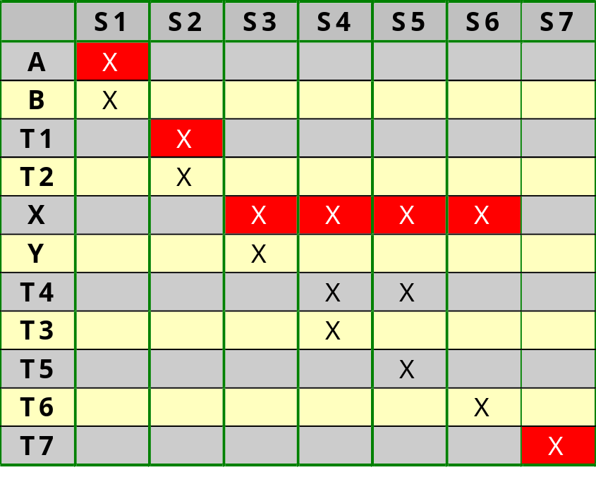
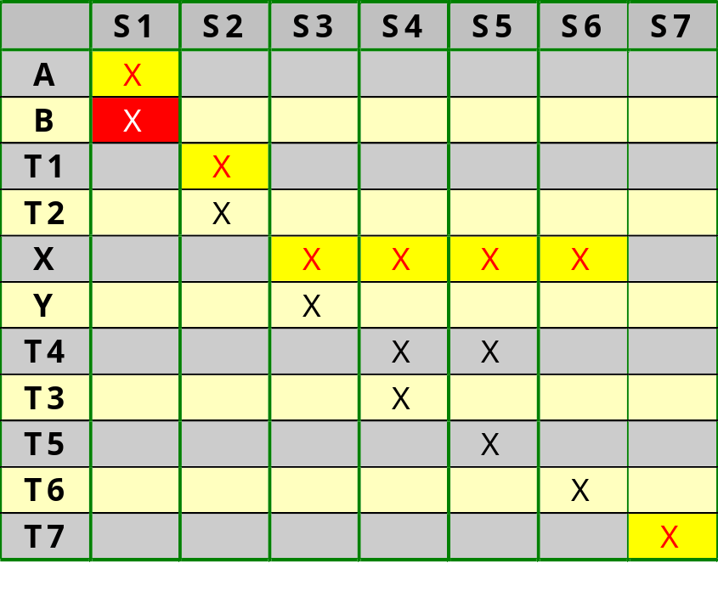
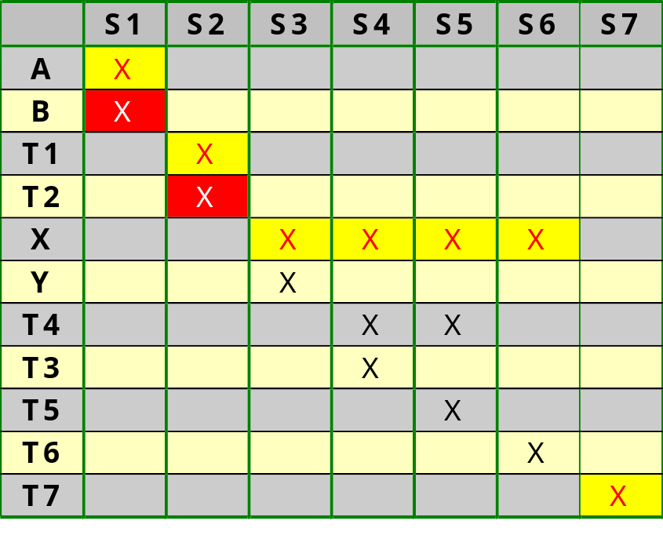
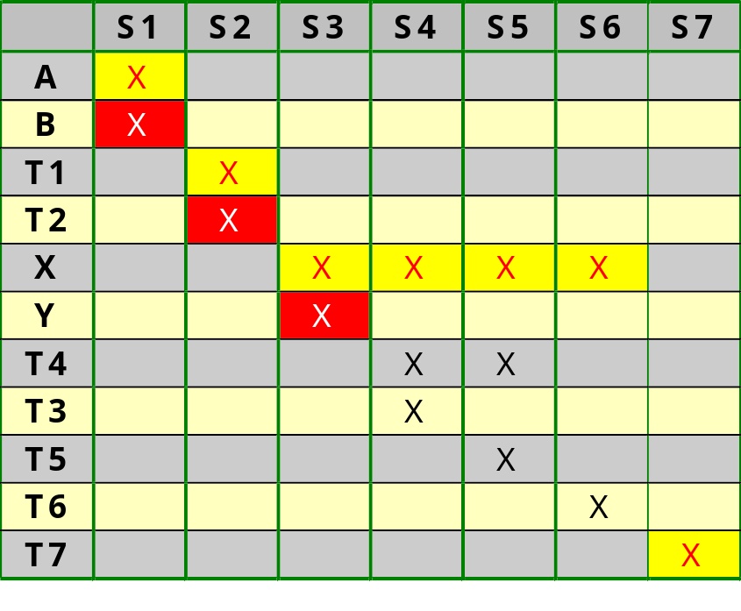
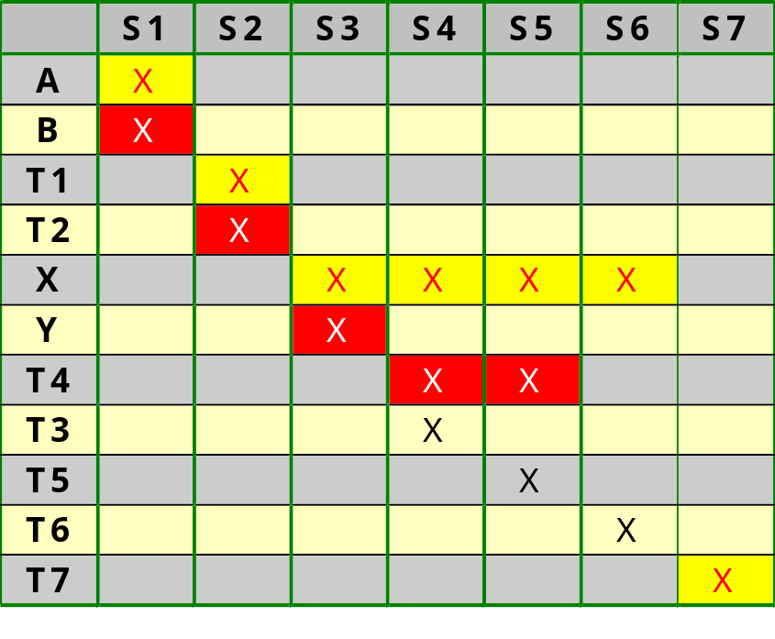
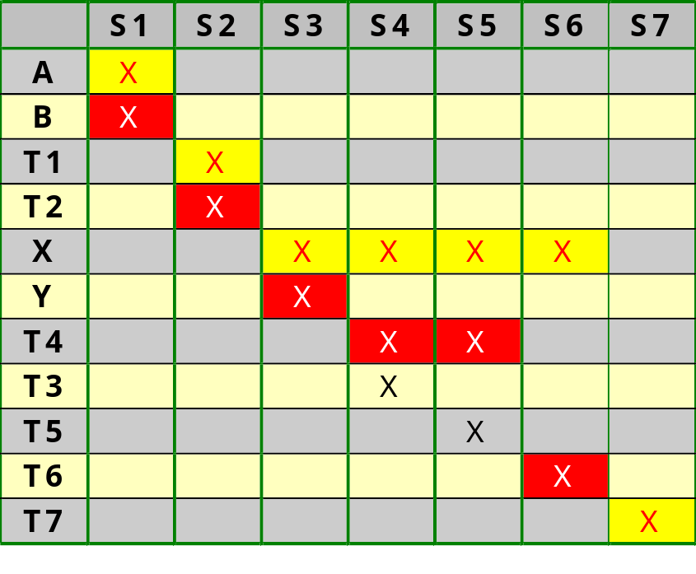
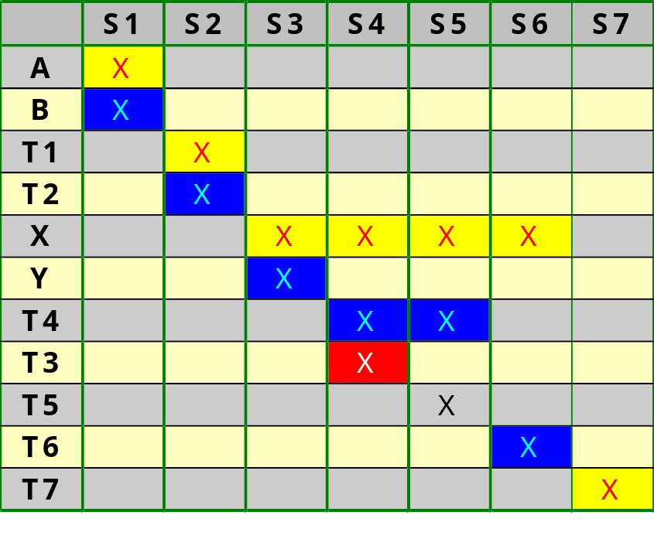
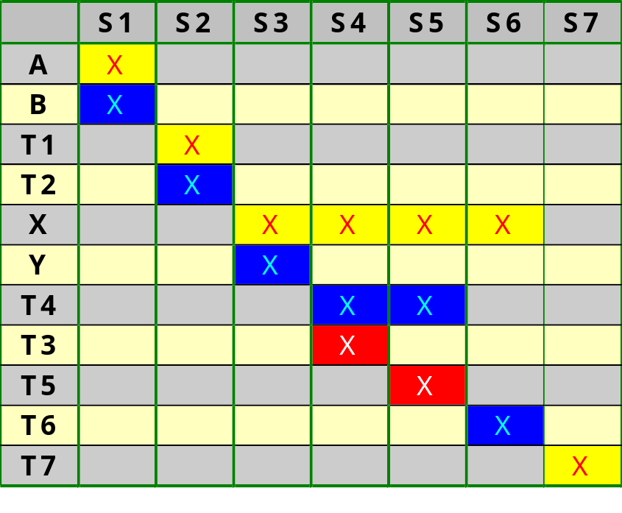
Register sharing
Allocate new register and assign non-overlapping variables
R1:
A
T1
X
T7
R2:
B
T2
Y
T4
T6
R3:
T3
T5

Slide 69
Register sharing
In1
In2
MUX
MUX
MUX
R1: a,t1,x,t7
R2: b,t2,y
t4,t6
R3: t3,t5
|a|
|b|
min
max
max
+
-
>>1
>>3
Out

Slide 70
Register sharing
The left-edge algorithm finds an assignment with the smallest number of registers
There exist however multiple possible variable-to-register assignments with the smallest number of registers
We hence can use a second cost criterion to find the best assignment
  First criterion: smallest number of registers
  Second criterion: minimize the number of ports of the MUX and DEMUX circuits
    preferably map two variables to the same register that are the same (e.g. left) input of the same functional unit
    preferably map two variables to the same register that are the same output of the same FU

Slide 71
Register sharing
Why does this register sharing reduces the cost of MUX and DEMUX?
R1: t1
R2: t2
MUX
R1: t1,t2
FU
FU
DEMUX
R2: t3,t4
R3: t3
R4: t4

Slide 72
Register sharing
We should hence determine which variables are the same input of the same functional unit and which variables are the same output of the same FU
However, at this stage of the design, before operator merging, each operator is implemented in a different FU such that no variables share the same input or output

Slide 73
Register sharing
Does this mean that we should do operator merging before register sharing?
  Register sharing: (1) minimize registers and (2) minimize size of MUX/DEMUX
    The latter is only known after operator merging
  Operator merging: merge operators where the combined cost of MUX/DEMUX/CombinedFU is smaller than the cost of two FUs
    The cost of the MUX/DEMUX is only known after register merging
  This deadlock situation is typical for all optimization steps in hardware synthesis (and software compilation)!! Solution:
    First optimize those things that give the largest cost improvement; use quick-and-dirty estimates for the next optimization steps
    Next optimize the things with less cost influence
    Iterate till satisfied with outcome

Slide 74
Register sharing
What gives the biggest cost influence: register sharing or operator merging
  In most cases, register sharing has a higher cost impact:
    there are more variables than FUs
    merging two registers in one does not increase the cost of the register; merging two different FUs in one makes this single FU more expensive than each of the original FUs separately
    it is easier to quickly estimate which operators will be merged, than to see which variables will be merged
  We hence mostly do register sharing first
    For some applications (e.g. when they contain only one type of FU) and some target platforms (e.g. where the cost of a register is negligible compared to the cost of an FU), we do operator merging first
    In an FPGA, a register at the FU output is free!

Slide 75
Register sharing
We choose to do register sharing first
We hence have to estimate operator merging
We assume that the 2 max-operators used in different states, will be combined into one max-operator
We assume that the subtraction and the addition used in different states, will be combined into one adder-subtractor

Slide 76
Register sharing
Method for register sharing, combined with MUX/DEMUX cost reduction:
  Build a compatibility graph
  Perform a max-cut graph partitioning

Slide 77
Register sharing
Build a compatibility graph
  Nodes are variables
    Hint: sort the nodes graphically according to the left-edge merging since this will already separate incompatible variables with overlapping lifetime
  Incompatibility edges are drawn between two variables with overlapping lifetime: they cannot be merged
  Priority edges are drawn between two variables that are the same input of the same FU or the same output of the same FU. A weight on this edge indicates how many times the two variables drive the same input of the same FU plus how many times they are the same output of the same FU.

Slide 78
Register sharing
a
t1
x
t7
b
t2
y
t4
t6
t3
t5
Nodes are variables
Result of left-edge algorithm:
R1: a, t1, x, t7
R2: b, t2, y, t4, t6
R3: t3, t5

Slide 79
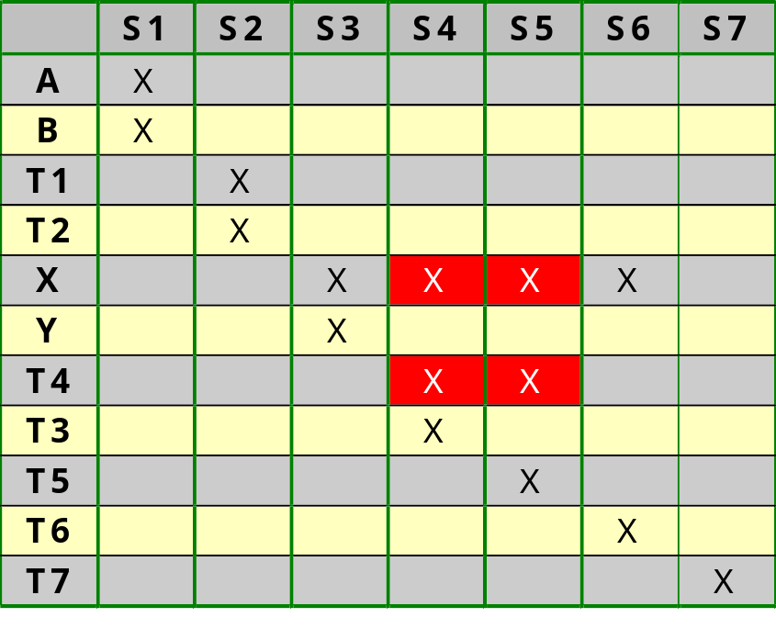
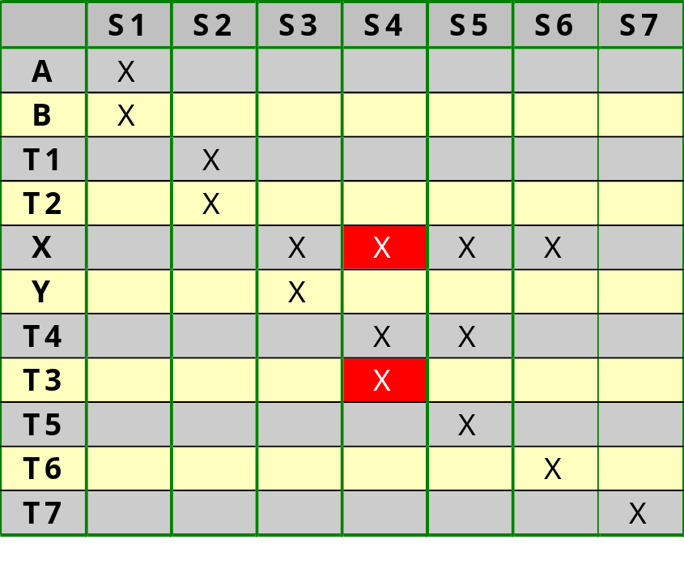
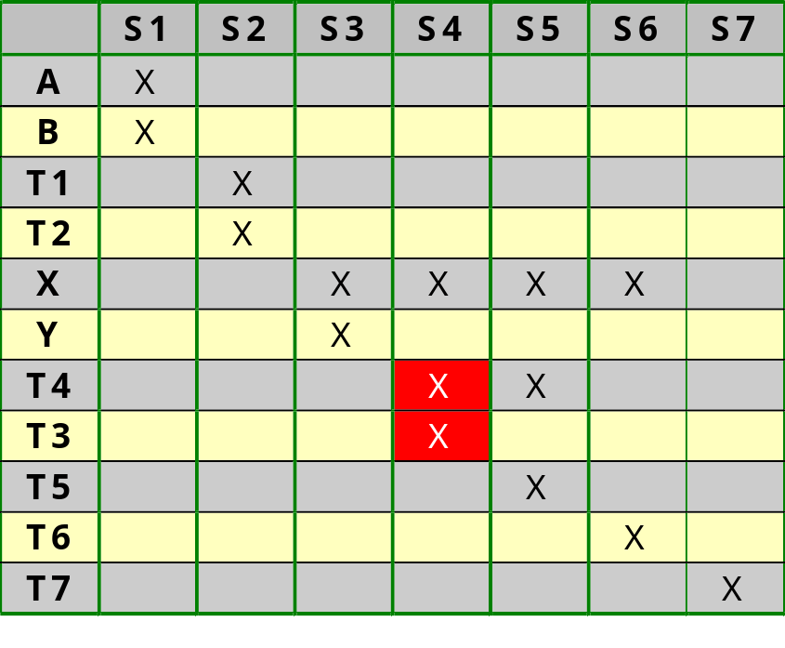
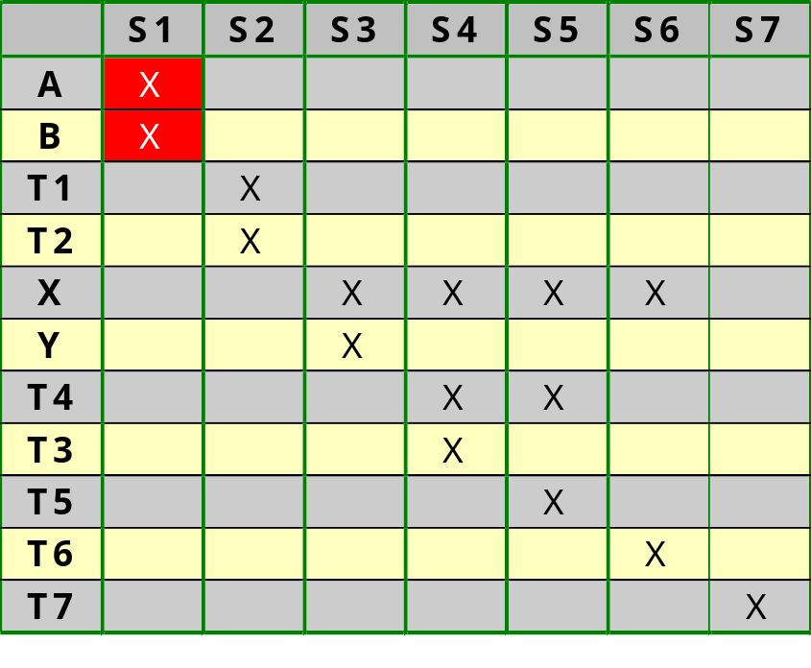
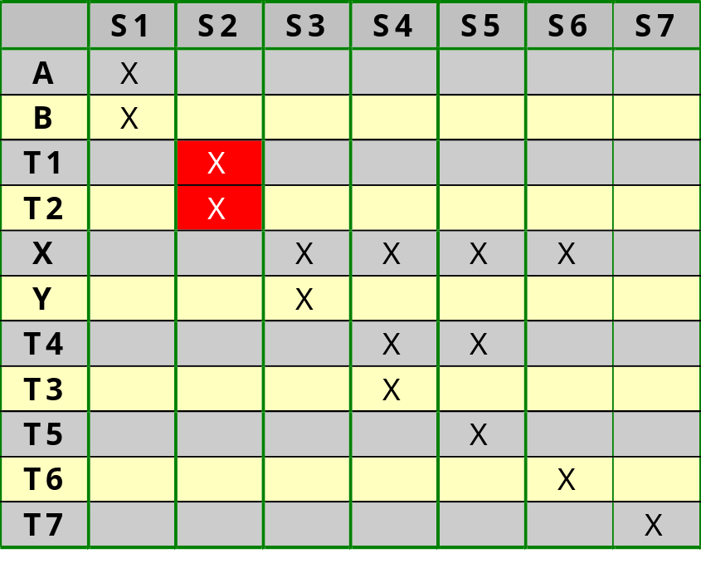
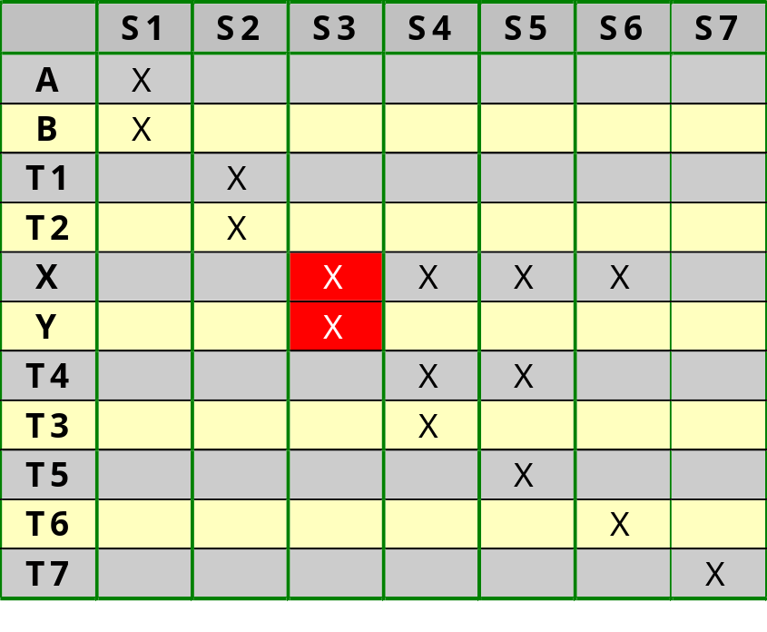
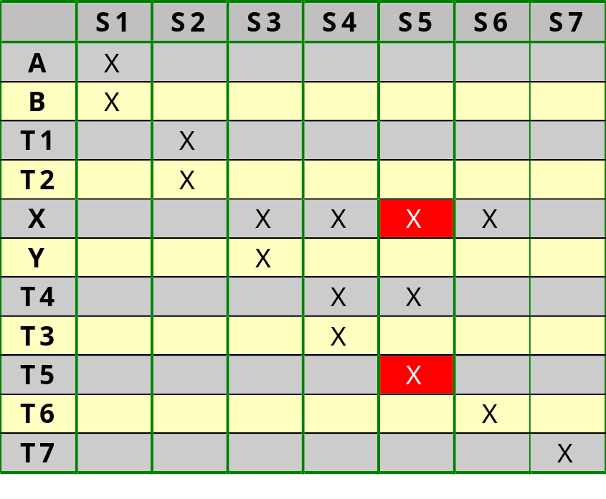
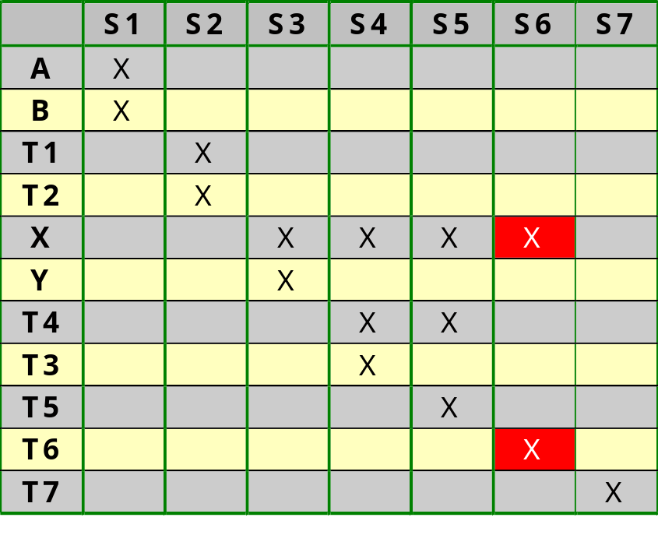
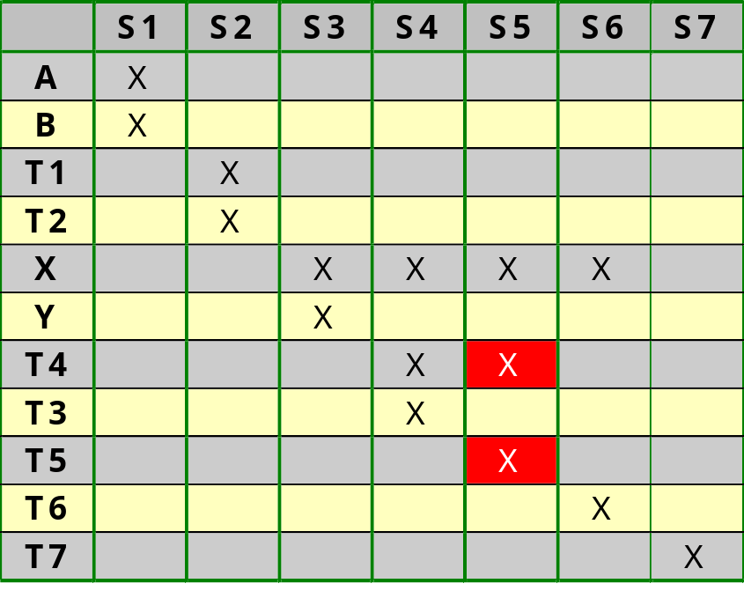
Register sharing
a
t1
x
t7
b
t2
y
t4
t6
t3
t5
Incompatibility edges:
variables with
overlapping lifetimes

Slide 80
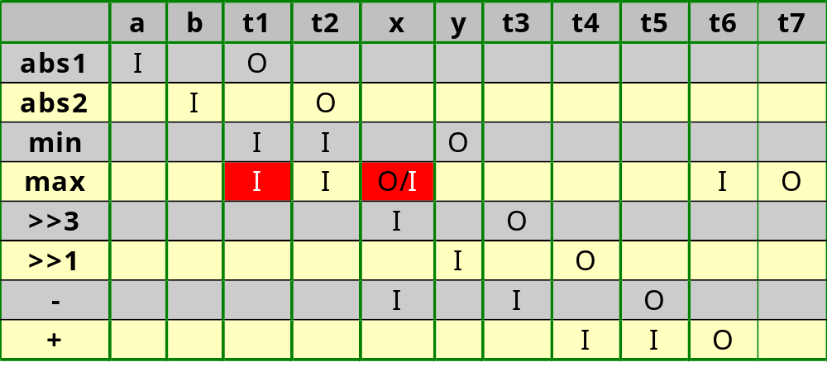
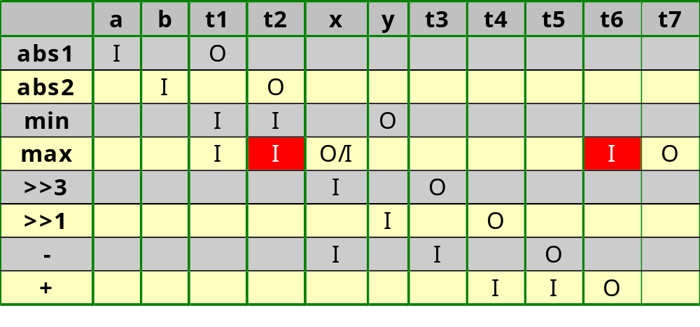
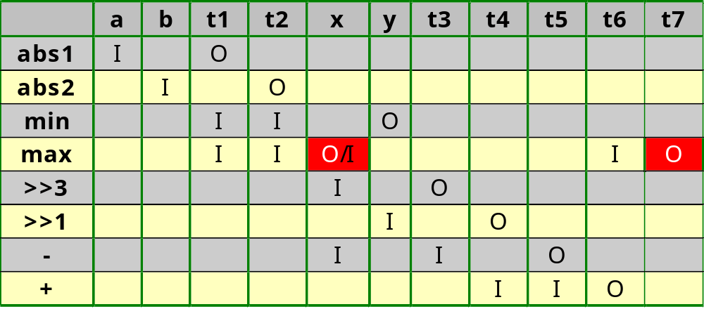
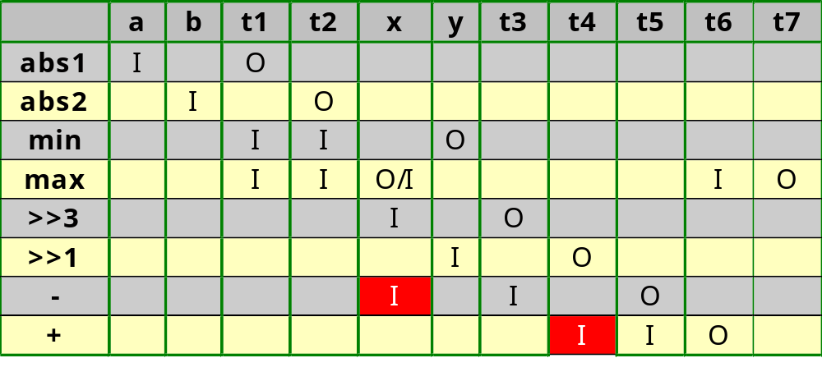
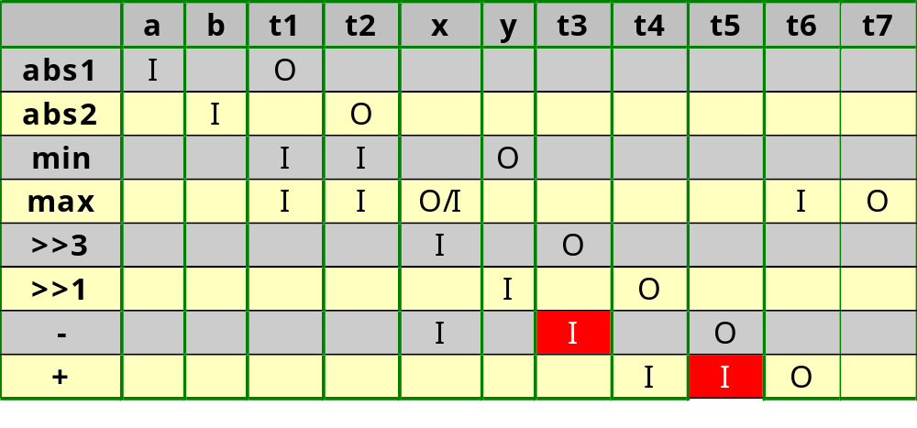
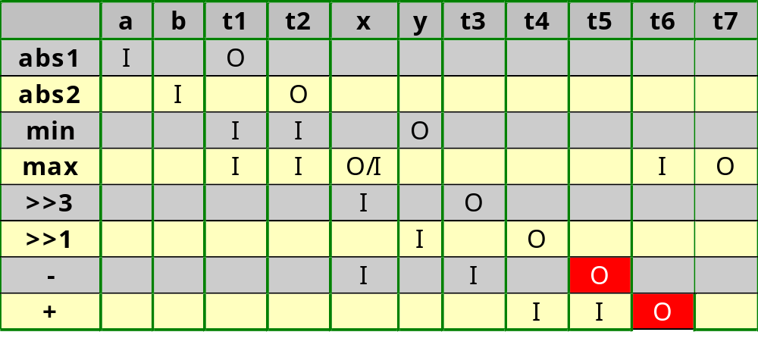
Register sharing
a
t1
1
x
1
t7
b
t2
y
t4
t6
1
1
t3
t5
1
x and t4 however have overlapping lifetimes:
no priority edge
Priority edges:
variables with
same input to
FU or same
output from FU

Slide 81
Register sharing
Perform a max-cut graph partitioning
  Divide the graph in the minimum number of clusters of compatible nodes, such that the total weight is maximized.
  Total weight is computed by summing all weights of priority edges within a cluster (a priority edge crossing cluster boundaries is not counted)
We are going to do this optimization visually
See course on optimization techniques for max-cut graph partitioning optimization algorithm

Slide 82
Register sharing
a
t1
1
x
1
t7
b
t2
y
t4
t6
1
1
t3
t5
1
x, t3 and t4 are mutually incompatible: each should
be assigned to a different register

Slide 83
Register sharing
1
1
1
a
t1
x
1
t7
Cut=2
b
t2
y
t4
t6
1
1
t3
t5
1
t1 and t7 may be assigned to the same register as x
since they are compatible and are connected by a
priority link with the highest weight in the graph, i.e. 1

Slide 84
Register sharing
1
1
1
a
t1
x
1
t7
Cut=5
b
t2
y
t4
t6
1
1
1
1
t3
t5
1
1
t2, t5 and t6 may be assigned to the same register as t3
since they are compatible and are connected by a
priority link with the highest weight in the graph, i.e. 1

Slide 85
Register sharing
1
1
1
a
t1
x
1
t7
Cut=5
b
t2
y
t4
t6
1
1
1
1
t3
t5
1
1
The three other variables do not have priority edges
and can be assigned to any register as long as they
are compatible with all other variables assigned to
the same register
Result of max-cut algorithm:
R1: a, t1, x, t7
R2: b, t2, t3, t5, t6
R3: y, t4
Result of left-edge algorithm:
R1: a, t1, x, t7
R2: b, t2, y, t4, t6
R3: t3, t5

Slide 86
Register sharing
In1
In2
MUX
MUX
MUX
R1: a,t1,x,t7
R2: b,t2,t3
t5,t6
R3: y,t4
|a|
|b|
min
max
max
+
-
>>1
>>3
Out

Slide 87
Register sharing
Register cost computation
  Cost of 1 bit register with CE and asynchronous preset or clear
    1/2 CLB
    7 gates
    34 TOR
  Cost of 1-bit 2-to-1 MUX
    1/2 CLB
    3 gates
    14 TOR
  Cost of 1-bit 4-to-1 MUX
    1 CLB
    5 gates
    36 TOR
  In FPGA, register and MUX share CLB
  5-to-1 MUX is 4-to-1 MUX followed by 2-to-1 MUX

Slide 88
Register sharing
Register cost computation for original FSMD implementation (32-bit data path):
  11 registers of 32 bits
    11 reg * 32 bit/reg * 1/2 CLB/bit = 176 CLB
    11 reg * 32 bit/reg * 7 gates/bit = 2464 gates
    11 reg * 32 bit/reg * 34 TOR/bit = 11968 TOR

Slide 89
Register sharing
Register cost computation for current FSMD implementation:
  1 register of 32 bits with 4-to-1 MUX
    1 CLB/MUXREGbit * 32 bit = 32 CLB
    (5 gates/MUXbit + 7 gates/REGbit) * 32 bit = 384 gates
    (36 TOR/MUXbit + 34 TOR/REGbit) * 32 bit = 2240 TOR
  1 register of 32 bits with 5-to-1 MUX
    (1 CLB/4MUXbit + 1/2 CLB/2MUXREGbit) * 32 bit = 48 CLB
    (5 gates/4MUXbit + 3 gates/2MUXbit + 7 gates/REGbit) * 32 bit = 480 gates
    (36 TOR/4MUXbit + 14 TOR/2MUXbit + 34 TOR/REGbit) * 32 bit = 2688 TOR

Slide 90
Register sharing
Register cost computation for current FSMD implementation:
  1 register of 32 bits with 2-to-1 MUX
    1/2 CLB/MUXREGbit * 32 bit = 16 CLB
    (3 gates/MUXbit + 7 gates/REGbit) * 32 bit = 320 gates
    (14 TOR/MUXbit + 34 TOR/REGbit) * 32 bit = 1536 TOR

Slide 91
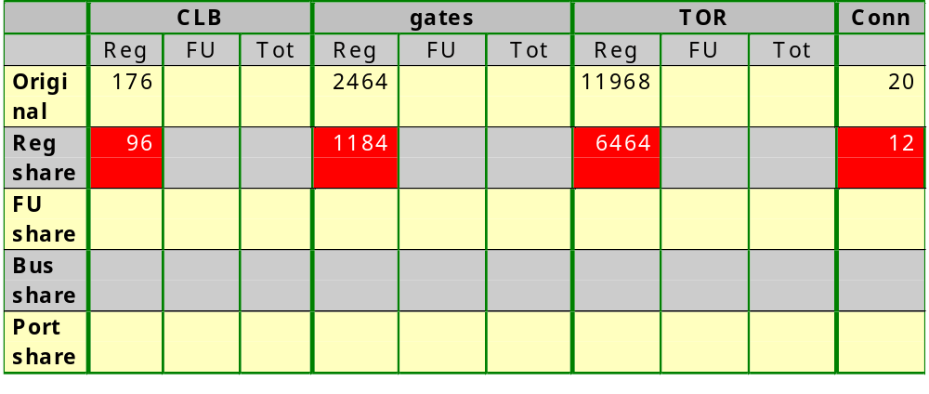
Register sharing
Note that register sharing also reduced the number of
connections: all 4 minimization steps influence each
other.
We could have made estimates of this reduction of
connections and used this for guiding the register sharing

Slide 92
FSMD design
FSMDs
Models
Synthesis techniques
  Basic principles
  Merging
    Register sharing (variable merging)
    Functional-unit sharing (operator merging)
    Bus sharing (connection merging)
    Register port sharing (register merging)

Slide 93
Functional-unit sharing
Basic principle:
  Replace two FUs that are not used at the same time by a single FU with combined functionality and by a MUX at each input and a DEMUX at each output
  Do this only when MUX/CombinedFU/DEMUX is cheaper than two FUs
a
b
c
d
a
c
b
d
MUX
MUX
FU1
FU2
FU1&2
DEMUX
x
y
x
y

Slide 94
Functional-unit sharing
When register sharing did a correct guess for FU sharing, the cost of the extra MUX and DEMUX will be small since input and output variables of both FUs will often be assigned to the same register
Which units can be shared:
  identical units (cf. 2 MAX units)
  different units (cf. ADD and SUBTRACT)

Slide 95
Functional-unit sharing
Build a compatibility graph
  Nodes are operators
  Incompatibility edges are drawn between two operators that are used in the same state: they cannot be merged
  Priority edges are drawn between two (or a group of n) operators that can be merged into the same FU. A weight on this edge indicates how large the cost saving is by merging the two (or n) operators.

Slide 96
Functional-unit sharing
ABS
MIN
SUB
>>3
ABS
MAX
MAX
ADD
>>1
Nodes are operators

Slide 97
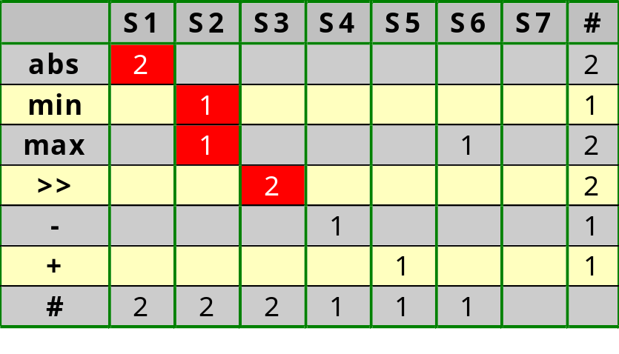
Functional-unit sharing
ABS
MIN
SUB
>>3
ABS
MAX
MAX
ADD
>>1
Incompatibility edge:
two operators needed
in same state

Slide 98
Functional-unit sharing
ABS
MIN
SUB
>>3
ABS
MAX
?
MAX
ADD
>>1
Priority edge:
weight indicates saving by sharing

Slide 99
Functional-unit sharing
Cost model for the MAX
a
b
a_{i}
b_{i}
c_{i}
subtract
Cost per bit:
- 1 CLB
- 8 gates
- 34 TOR
MUX
Sign
max(a,b)
c_{i+1}
Only carry logic, but
for MSB where we need
the sum logic:
1/2 CLB/bit
5 gates/bit
20 TOR/bit
1/2 CLB/bit
3 gates/bit
14 TOR/bit

Slide 100
Functional-unit sharing
Cost model for one FU ≡ (MAX&MAX)
R1
R2
R1
R2
Cost:
2 CLB
16 gate
68 TOR
R1=MAX(R1,R2)
&
R1=MAX(R1,R2)
R1
R1
R1
R2
Cost:
1 CLB
8 gate
34 TOR
Savings:
1 CLB
8 gate
34 TOR
R1=MAX(R1,R2)
R1
Note that this was only possible by mapping
corresponding operands and result to same register

Slide 101
Functional-unit sharing
ABS
MIN
SUB
>>3
ABS
MAX
1/8/34
MAX
ADD
>>1
?

Slide 102
Functional-unit sharing
Cost model for the ABS
a
Cost per bit:
- 1/2 CLB (using carry chain)
- 6 gates
- 34 TOR
negator
MUX
Sign: a_{n-1}
|a|
a_{n-1}
2 gates
(AND & XOR)
18 TOR
(6 + 12)
a₁
a₀
HA
HA
HA
1
a_{n-1}
MUX
MUX
MUX
|a_{n-1}|
|a₁|
|a₀|

Slide 103
Functional-unit sharing
Cost model for one FU≡(ABS&MAX&MAX)
R2
R1
R2
R1
R2
Cost:
2.5 CLB
22 gate
102 TOR
R2=ABS(R2)
R1=MAX(R1,R2)
R1=MAX(R1,R2)
&
&
R2
R1
R1
R1
R2
R2=ABS(R2)
R1=MAX(R1,R2)
Cost:
?
R1

Slide 104
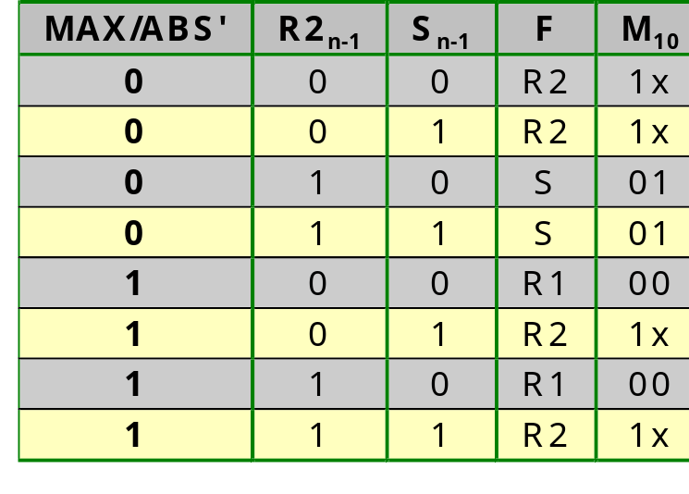
Functional-unit sharing
Structure of an ABS&MAX unit
R1
R2
MAX/ABS’
FA
1
R1
S
R2
Cost per bit:
• 1/2 CLB (FA&INV) + 1/2 CLB
(AND) + 1 (MUX) = 2 CLB
• 5 gates (FA) + 1 (AND) + 1 (INV)
+ 4 (MUX) = 11 gates
• 36 TOR (FA) + 6 (AND) + 2 (INV)
+ 22 (MUX) = 66 TOR
M₁
M₀
00 01 1x
F
R2 appears
most in table:
most don’t
cares is best

Slide 105
Functional-unit sharing
Cost model for one FU≡(ABS&MAX&MAX)
R2
R1
R2
R1
R2
Cost:
2.5 CLB
22 gate
102 TOR
R2=ABS(R2)
R1=MAX(R1,R2)
R1=MAX(R1,R2)
&
&
R2
R1
R1
R1
R2
Cost:
2 CLB
11 gates
66 TOR
Savings:
0.5 CLB
11 gate
36 TOR
R2=ABS(R2)
R1=MAX(R1,R2)
R1

Slide 106
Functional-unit sharing
ABS
?
MIN
SUB
>>3
ABS
MAX
1/8/34
MAX
ADD
>>1
0.5/11/36

Slide 107
Functional-unit sharing
Cost model for the MIN
a
b
a_{i}
b_{i}
c_{i}
subtract
Cost per bit:
- 1 CLB
- 8 gates
- 34 TOR
MUX
Sign
min(a,b)
c_{i+1}
Only carry logic, but
for MSB where we need
the sum logic:
1/2 CLB/bit
5 gates/bit
20 TOR/bit
1/2 CLB/bit
3 gates/bit
14 TOR/bit

Slide 108
Functional-unit sharing
Cost model for one FU≡(ABS&MIN)
R1
R1
R2
Cost:
1.5 CLB
14 gate
68 TOR
R1=ABS(R1)
R3=MIN(R1,R2)
&
R1
R3
R1
R2
R1=ABS(R1)
R3=MAX(R1,R2)
Cost:
?
R1/R3

Slide 109
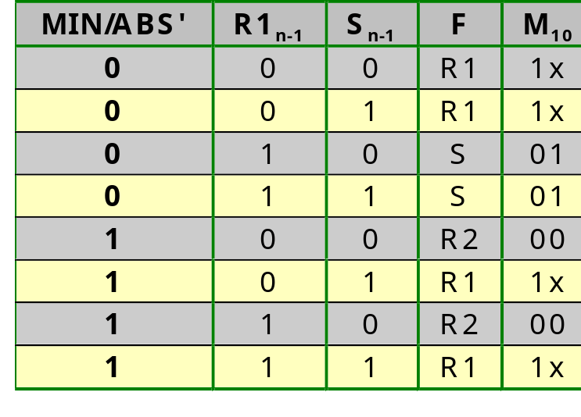
Functional-unit sharing
Structure of an ABS&MIN unit
R1
R2
MIN/ABS’
MIN/
ABS’
MUX
FA
1
R1
S
R2
Cost per bit:
• 1/2 CLB (FA) + 1/2 CLB (AND)
+ 1/2 CLB (MUX&INV)
+ 1 (MUX) = 2.5 CLB
• 5 gates (FA) + 1 (AND) + 3 (MUX
&INV) + 4 (MUX) = 13 gates
• 36 TOR (FA) + 6 (AND) + 16 (MUX
&INV) + 22 (MUX) = 80 TOR
M₁
M₀
1x 01 00
F

Slide 110
Functional-unit sharing
Cost model for one FU≡(ABS&MIN)
R1
R1
R2
Cost:
1.5 CLB
14 gate
68 TOR
R1=ABS(R1)
R3=MIN(R1,R2)
&
R1
R3
R1
R2
Cost:
2.5 CLB
13 gates
80 TOR
Savings:
-1 CLB
1 gate
-12 TOR
R1=ABS(R1)
R3=MAX(R1,R2)
R1/R3
It does not seem
to be a good idea
to share ABS and MIN

Slide 111
Functional-unit sharing
-1/1/
-12
ABS
MIN
SUB
>>3
?
ABS
MAX
1/8/34
MAX
ADD
>>1
0.5/11/36

Slide 112
Functional-unit sharing
Cost model for the ADD
Cost per bit:
- 1/2 CLB
- 5 gates
- 36 TOR
x_{i}
y_{i}
c_{i}
s_{i}
c_{i+1}

Slide 113
Functional-unit sharing
Cost model for the SUB
Cost per bit:
- 1/2 CLB
- 6 gates
- 38 TOR
a₃
b₃
a₂
b₂
a₁
b₁
a₀
b₀
c₄
FA
c₃
FA
c₂
FA
c₁
FA
1
f₃
f₂
f₁
f₀

Slide 114
Functional-unit sharing
Cost model for one FU≡(ADD&SUB)
R3
R2
R1
R2
Cost:
1 CLB
11 gate
74 TOR
R2=ADD(R3,R2)
R2=SUB(R1,R2)
&
R2
R2
R1
R2
R3
R2=ADD(R3,R2)
R2=SUB(R1,R2)
Cost:
?
R2

Slide 115
Functional-unit sharing
Structure of an ADD&SUB unit
R1
R3
A/
S’
R2
A/S’
MUX
It is not clear
whether MUX
fits in same
CLB
FA
A’/S
S
Cost per bit:
• 1/2 CLB (FAS&MUX)
• 6 gates (FAS) + 3 (MUX) =
13 gates
• 48 TOR (FAS) + 14 (MUX) =
62 TOR

Slide 116
Functional-unit sharing
Cost model for one FU≡(ADD&SUB)
R3
R2
R1
R2
Cost:
1 CLB
11 gate
74 TOR
R2=ADD(R3,R2)
R2=SUB(R1,R2)
&
R2
R2
R1
R2
R3
Cost:
1/2 CLB
9 gates
62 TOR
Savings:
0.5 CLB
2 gate
12 TOR
R2=ADD(R3,R2)
R2=SUB(R1,R2)
R2

Slide 117
Functional-unit sharing
-1/1/
-12
ABS
MIN
SUB
>>3
0.5/
2/12
ABS
MAX
1/8/34
MAX
ADD
>>1
0.5/11/36
?

Slide 118
Functional-unit sharing
Cost model for one FU≡(MAX&MAX&ADD)
R1
R2
R1
R2
R3
R2
Cost:
2.5 CLB
21 gate
104 TOR
R1=MAX(R1,R2)
R1=MAX(R1,R2)
R2=ADD(R3,R2)
&
&
R1
R1
R2
R1
R2
R3
R1=MAX(R1,R2)
R1=MAX(R1,R2)
R2=ADD(R3,R2)
Cost:
?
R1/R2

Slide 119
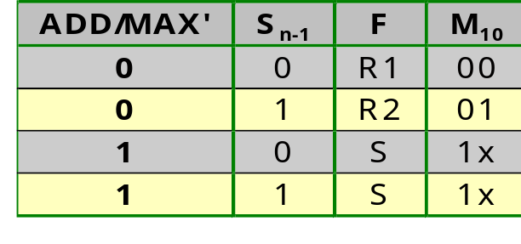
Functional-unit sharing
Structure of an ADD&MAX unit
R1
R3
A/
M’
R2
A/M’
MUX
M₁ = ADD/MAX’
M₀ = S_{n-1}
FA
1
It is not clear
whether MUX
fits in same
CLB
R1
S
R2
Cost per bit:
• 1/2 CLB (FAS&MUX)
+ 1 (MUX) = 1.5 CLB
• 6 gates (FAS) + 3 (MUX)
+ 4 (MUX) = 13 gates
• 48 TOR (FAS) + 12 (MUX)
+ 22 (MUX) = 82 TOR
M₁
M₀
00 1x 01
F

Slide 120
Functional-unit sharing
Cost model for one FU≡(MAX&MAX&ADD)
R1
R2
R1
R2
R3
R2
Cost:
2.5 CLB
21 gate
104 TOR
R1=MAX(R1,R2)
R1=MAX(R1,R2)
R2=ADD(R3,R2)
&
&
R1
R1
R2
R1
R2
R3
Cost:
1.5 CLB
13 gates
82 TOR
Savings:
1 CLB
8 gate
22 TOR
R1=MAX(R1,R2)
R1=MAX(R1,R2)
R2=ADD(R3,R2)
R1/R2

Slide 121
Functional-unit sharing
-1/1/
-12
ABS
MIN
SUB
>>3
0.5/
2/12
ABS
MAX
1/8/34
MAX
ADD
>>1
0.5/11/36
1/8/22
?

Slide 122
Functional-unit sharing
Cost model FU≡(ABS&MAX&MAX&ADD)
R2
R1
R2
R1
R2
R3
R2
Cost:
3 CLB
27 gate
138 TOR
R2=ABS(R2)
R1=MAX(R1,R2)
R1=MAX(R1,R2)
R2=ADD(R3,R2)
&
&
&
R2
R1
R1
R2
R1
R2
R3
R2=ABS(R2)
R1=MAX(R1,R2)
R2=ADD(R3,R2)
Cost:
?
R1/R2

Slide 123
Functional-unit sharing
Structure of an ABS&MAX&ADD unit
R1
R3
A/
M’
R2
Else/ABS’
0
MUX
ADD/MAX’
FA
R1
S
R2
Cost per bit:
• 1/2 CLB (FAS) + 1/2 CLB (MUX)
+ 1 (MUX) = 2 CLB
• 6 gates (FAS) + 3 (MUX)
+ 4 (MUX) = 13 gates
• 48 TOR (FAS) + 16 (MUX)
+ 22 (MUX) = 86 TOR
M₁
M₀
00 1x 01
F

Slide 124
Functional-unit sharing
Cost model FU≡(ABS&MAX&MAX&ADD)
R2
R1
R2
R1
R2
R3
R2
Cost:
3 CLB
27 gate
138 TOR
R2=ABS(R2)
R1=MAX(R1,R2)
R1=MAX(R1,R2)
R2=ADD(R3,R2)
&
&
&
R2
R1
R1
R2
R1
R2
R3
Cost:
2 CLB
13 gates
86 TOR
Savings:
1 CLB
14 gate
52 TOR
R2=ABS(R2)
R1=MAX(R1,R2)
R2=ADD(R3,R2)
R1/R2

Slide 125
Functional-unit sharing
-1/1/
-12
ABS
MIN
SUB
>>3
?
0.5/
2/12
ABS
MAX
1/8/34
MAX
ADD
>>1
0.5/11/36
1/8/22
1/14/52

Slide 126
Functional-unit sharing
FU≡(ABS&MAX&MAX&ADD&SUB)
R2
R1
R2
R1
R2
R3
R2
Cost:
3.5 CLB
33 gate
176 TOR
R2=ABS(R2)
R1=MAX(R1,R2)
R1=MAX(R1,R2)
R2=ADD(R3,R2)
&
&
&
R2
R1
R1
R2
R1
R2
R2=SUB(R1,R2)
&
R2
R1
R2
R3
R2=ABS(R2)
R1=MAX(R1,R2)
R2=ADD(R3,R2)
R2=SUB(R1,R2)
Cost:
?
R1/R2

Slide 127
Functional-unit sharing
Structure of an ABS&MAX&ADD&SUB unit
R1
R3
R2
0
MUX
FA
R1
S
R2
Cost per bit:
• 1/2 CLB (FAS) + 1/2 CLB (MUX)
+ 1 (MUX) = 2 CLB
• 6 gates (FAS) + 3 (MUX)
+ 4 (MUX) = 13 gates
• 48 TOR (FAS) + 16 (MUX)
+ 22 (MUX) = 86 TOR
M₁
M₀
00 1x 01
F

Slide 128
Functional-unit sharing
FU≡(ABS&MAX&MAX&ADD&SUB)
R2
R1
R2
R1
R2
R3
R2
Cost:
3.5 CLB
33 gate
176 TOR
R2=ABS(R2)
R1=MAX(R1,R2)
R1=MAX(R1,R2)
R2=ADD(R3,R2)
&
&
&
R2
R1
R1
R2
R1
R2
R2=SUB(R1,R2)
&
R2
R1
R2
R3
Cost:
2 CLB
13 gates
86 TOR
Savings:
1.5 CLB
20 gate
90 TOR
R2=ABS(R2)
R1=MAX(R1,R2)
R2=ADD(R3,R2)
R2=SUB(R1,R2)
R1/R2

Slide 129
Functional-unit sharing
-1/1/
-12
ABS
MIN
?
SUB
>>3
1.5/20/90
0.5/
2/12
ABS
MAX
1/8/34
MAX
ADD
>>1
0.5/11/36
1/8/22
1/14/52

Slide 130
Functional-unit sharing
FU≡(MIN&SUB)
R1
R2
R1
R2
Cost:
1.5 CLB
14 gate
72 TOR
R3=MIN(R1,R2)
R2=SUB(R1,R2)
&
R3
R2
R1
R2
R3=MIN(R1,R2)
R2=SUB(R1,R2)
Cost:
?
R2/R3

Slide 131
Functional-unit sharing
Structure of a MIN&SUB unit
R1
R2
FA
1
R1
S
R2
Cost per bit:
• 1/2 CLB (FA&INV)
+ 1 (MUX) = 1.5 CLB
• 5 gates (FA) + 1 (INV)
+ 4 (MUX) = 10 gates
• 36 TOR (FA) + 2 (INV)
+ 22 (MUX) = 60 TOR
M₁
M₀
00 01 1x
F

Slide 132
Functional-unit sharing
FU≡(MIN&SUB)
R1
R2
R1
R2
Cost:
1.5 CLB
14 gate
72 TOR
R3=MIN(R1,R2)
R2=SUB(R1,R2)
&
R3
R2
R1
R2
Cost:
1.5 CLB
10 gates
60 TOR
Savings:
0 CLB
4 gate
12 TOR
R3=MIN(R1,R2)
R2=SUB(R1,R2)
R2/R3

Slide 133
Functional-unit sharing
?
-1/1/
-12
ABS
MIN
0/4/12
SUB
>>3
1.5/20/90
0.5/
2/12
ABS
MAX
1/8/34
MAX
ADD
>>1
0.5/11/36
1/8/22
1/14/52

Slide 134
Functional-unit sharing
Cost model for one FU≡(ABS&MIN&SUB)
R1
R1
R2
R1
R2
Cost:
2 CLB
20 gate
106 TOR
R1=ABS(R1)
R3=MIN(R1,R2)
R2=SUB(R1,R2)
&
&
R1
R3
R2
R1
R2
R1=ABS(R1)
R3=MAX(R1,R2)
R2=SUB(R1,R2)
Cost:
?
R1/R2/R3

Slide 135
Functional-unit sharing
Structure of an ABS&MIN&SUB unit
R1
R2
MUX
FA
1
R1
S
R2
Cost per bit:
• 1/2 CLB (FA) + 1/2 (AND) + 1/2
(MUX&INV) + 1 (MUX) = 2.5 CLB
• 5 gates (FA) + 1 (AND) + 3 (MUX
&INV) + 4 (MUX) = 13 gates
• 36 TOR (FA) + 6 (AND) + 16 (MUX
&INV) + 22 (MUX) = 80 TOR
M₁
M₀
00 01 1x
F

Slide 136
Functional-unit sharing
Cost model for one FU≡(ABS&MIN&SUB)
R1
R1
R2
R1
R2
Cost:
2 CLB
20 gate
106 TOR
R1=ABS(R1)
R3=MIN(R1,R2)
R2=SUB(R1,R2)
&
&
R1
R3
R2
R1
R2
Cost:
2.5 CLB
13 gates
80 TOR
Savings:
-0.5 CLB
7 gate
26 TOR
R1=ABS(R1)
R3=MAX(R1,R2)
R2=SUB(R1,R2)
R1/R2/R3

Slide 137
Functional-unit sharing
-0.5/7/26
-1/1/
-12
ABS
MIN
0/4/12
SUB
>>3
1.5/20/90
0.5/
2/12
ABS
MAX
1/8/34
MAX
ADD
>>1
0.5/11/36
1/8/22
1/14/52
Is it useful to share the SHIFTs with other FUs?

Slide 138
Functional-unit sharing
Cost models for the FUs: SHIFT
Cost per bit:
- 0 CLB
- 0 gates
- 0 TOR
>>1
Since the SHIFTs do not cost
anything, cost can only increase
by combining them with other
operators
>>3

Slide 139
Functional-unit sharing
-0.5/7/26
-1/1/
-12
ABS
MIN
0/4/12
SUB
>>3
1.5/20/90
0.5/
2/12
ABS
MAX
1/8/34
MAX
ADD
>>1
0.5/11/36
1/8/22
1/14/52
This is our compatibility graph; although there are
still other sharings possible, I assume they won’t
yield better cost
Note that max-cut graph partitioning is not well suited
when the saving of sharing 3 nodes is not the sum of
the savings of the 3 couples of 2 nodes.

Slide 140
Functional-unit sharing
Cost minimization for FPGA
-0.5
ABS
-1
MIN
0
SUB
>>3
1.5
0.5
ABS
MAX
1
MAX
ADD
>>1
0.5
1
1
Possibility 1: (ABS), (MIN), (ABS&MAX&MAX&ADD&SUB),
(>>3), (>>1): saves 1.5 CLBs, costs 3.5 CLBs

Slide 141
Functional-unit sharing
Cost minimization for FPGA
-0.5
ABS
-1
MIN
0
SUB
>>3
1.5
0.5
ABS
MAX
1
MAX
ADD
>>1
0.5
1
1
Possibility 1: (ABS), (MIN), (ABS&MAX&MAX&ADD&SUB),
(>>3), (>>1): saves 1.5 CLBs, costs 3.5 CLBs
Possibility 2: (ABS), (MIN&SUB&ADD), (ABS), (MAX&MAX),
(>>3), (>>1): saves 1.5 CLBs, costs 3.5 CLBs
Poss. 2 requires 1 FU more ( more connections)

Slide 142
Functional-unit sharing
Cost minimization for gate arrays
7
ABS
1
MIN
4
SUB
>>3
20
2
ABS
MAX
8
MAX
ADD
>>1
11
8
14
Possibility 1: (ABS&MIN), (ABS&MAX&MAX&ADD&SUB),
(>>3), (>>1): saves 21 gates, costs 26 gates

Slide 143
Functional-unit sharing
Cost minimization for gate arrays
7
ABS
1
MIN
4
SUB
>>3
20
2
ABS
MAX
8
MAX
ADD
>>1
11
8
14
Possibility 1: (ABS&MIN), (ABS&MAX&MAX&ADD&SUB),
(>>3), (>>1): saves 21 gates, costs 26 gates
Possibility 2: (ABS&MIN&SUB), (ABS&MAX&MAX&ADD),
(>>3), (>>1): saves 21 gates, costs 26 gates

Slide 144
Functional-unit sharing
Cost minimization for CMOS ASICs
26
ABS
-12
MIN
12
SUB
>>3
90
12
ABS
MAX
34
MAX
ADD
>>1
36
22
52
Possibility 1: (ABS), (MIN), (ABS&MAX&MAX&ADD&SUB),
(>>3), (>>1): saves 90 TOR, costs 154 TOR

Slide 145
Functional-unit sharing
We select solution 1 for FPGA
-0.5
ABS
-1
MIN
0
SUB
>>3
1.5
0.5
ABS
MAX
1
MAX
ADD
>>1
0.5
1
1
FU1: ABS (1/2 CLB/bit)
FU2: MIN (1 CLB/bit)
FU3: ABS, MAX, MAX, ADD, SUB (2 CLB/bit)
FU4: >>3 (0 CLB/bit)
FU5: >>1 (0 CLB/bit)

Slide 146
Functional-unit sharing
In1
In2
MUX
MUX
MUX
R1: a,t1,x,t7
R2: b,t2,t3
t5,t6
R3: y,t4
MUX
FU1
FU2
FU3
FU4
FU5
Out

Slide 147
Functional-unit sharing
Note that functional-unit sharing reduced the number of ports of the register MUXes; we guided register sharing already with this in mind
We should hence recalculate register cost
  Cost of 1-bit 3-to-1 MUX
    1 CLB
    4 gates
    28 TOR
  Cost of 1-bit 2-to-1 MUX
    1/2 CLB
    3 gates
    14 TOR
  Cost of 1-bit register
    1/2 CLB
    7 gates
    34 TOR

Slide 148
Functional-unit sharing
Register cost computation for current FSMD implementation:
  2 registers of 32 bits with 3-to-1 MUX; each register costs:
    1 CLB/MUXREGbit * 32 bit = 32 CLB
    (4 gates/MUXbit + 7 gates/REGbit) * 32 bit = 352 gates
    (28 TOR/MUXbit + 34 TOR/REGbit) * 32 bit = 1984 TOR
  1 register of 32 bits with 2-to-1 MUX
    0.5 CLB/MUXREGbit * 32 bit = 16 CLB
    (3 gates/MUXbit + 7 gates/REGbit) * 32 bit = 320 gates
    (14 TOR/MUXbit + 34 TOR/REGbit) * 32 bit = 1536 TOR

Slide 149
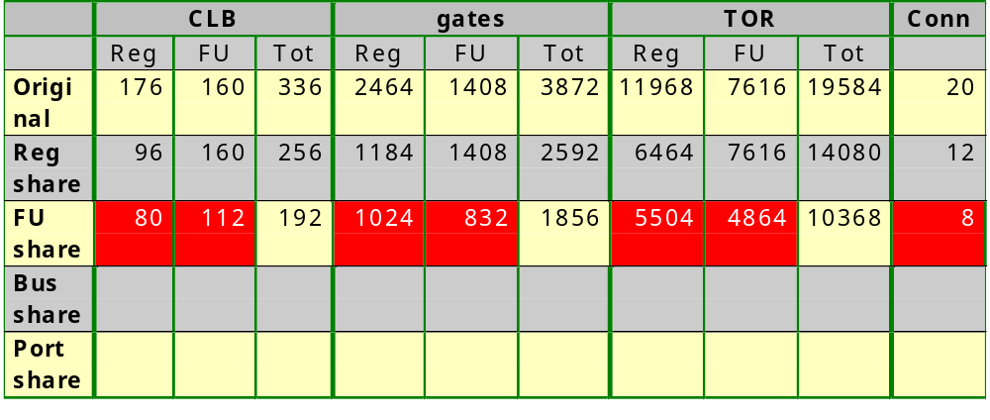
Functional-unit sharing
Note that functional unit sharing also reduced the number
of registers as well as connections: all 4 minimization
steps influence each other.
We could have made estimates of the reduction of
connections and used this for guiding the FU sharing

Slide 150
FSMD design
FSMDs
Models
Synthesis techniques
  Basic principles
  Merging
    Register sharing (variable merging)
    Functional-unit sharing (operator merging)
    Bus sharing (connection merging)
    Register port sharing (register merging)

Slide 151
Bus sharing
Basic principle:
  Replace two connections that are not used at the same time by a single connection
  This reduces wiring, which in today’s circuits became the predominant cost
  at the cost of requiring tri-state drivers each time two different sources drive the same bus
  but also saving MUXes each time two different connections driving the same destination are replaced by a single bus
R1
R2
R1
R2
MUX
FU1
FU1

Slide 152
Bus sharing
Since wiring cost is so high for buses, we search for the absolute minimum number of buses, without looking at the increased cost for drivers
When several solutions lead to the same number of buses, we choose that combination that has the minimum number of tri-state drivers at the sources and MUXes at the destinations

Slide 153
Bus sharing
Build a compatibility graph for the connections from registers to functional units and a second compatibility graph for the connections from functional units to registers
  Nodes are connections
  Incompatibility edges are drawn between two connections that are used in the same state and have different sources
  Priority edges are drawn between two connections that have the same source (saves on tri-state drivers) or the same destination (saves on input MUXes)

Slide 154
Bus sharing
In1
In2
MUX
MUX
MUX
R1: a,t1,x,t7
R2: b,t2,t3
t5,t6
R3: y,t4
A
B
C
D
E
F
G
H
I
MUX
FU1
FU2
FU3
FU4
FU5
Out
Name all input connections for the FUs

Slide 155
Bus sharing
Build the compatibility graph: nodes are connections
A
I
B
H
C
G
D
F
E

Slide 156
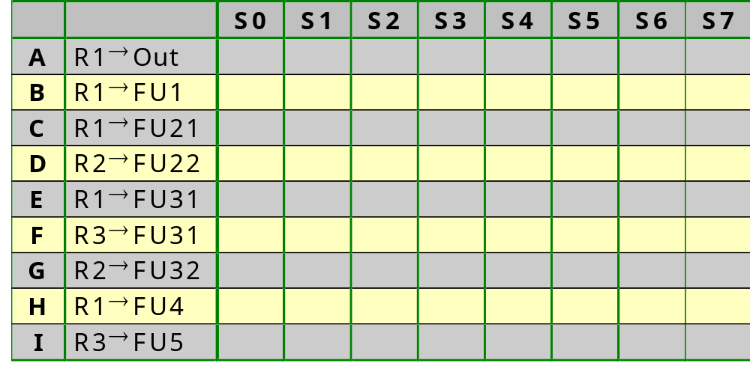
Bus sharing
In which state is each connection used? From which source and to which destination do they go?

Slide 157
Bus sharing
a=In1
b=In2
R1: a,t1,x,t7
R2: b,t2,t3,t5,t6
R3: y,t4
R1=In1
R2=In2
0
Start
Start
Out=t7
Out=R1
1
FU1: ABS
FU2: MIN
FU3: ABS, MAX,MAX,
ADD, SUB
FU4: >>3
FU5: >>1
t1=|a|
t2=|b|
R1=F1(R1)
R2=F3(R2)
t7=max(t6,x)
R1=F3(R1,R2)
x=max(t1,t2)
y=min(t1,t2)
R1=F3(R1,R2)
R3=F2(R1,R2)
t6=t4+t5
R2=F3(R3,R2)
t3=x>>3
t4=y>>1
R2=F4(R1)
R3=F5(R3)
t5=x-t3
R2=F3(R1,R2)
Rewrite taking into account register and FU sharing

Slide 158
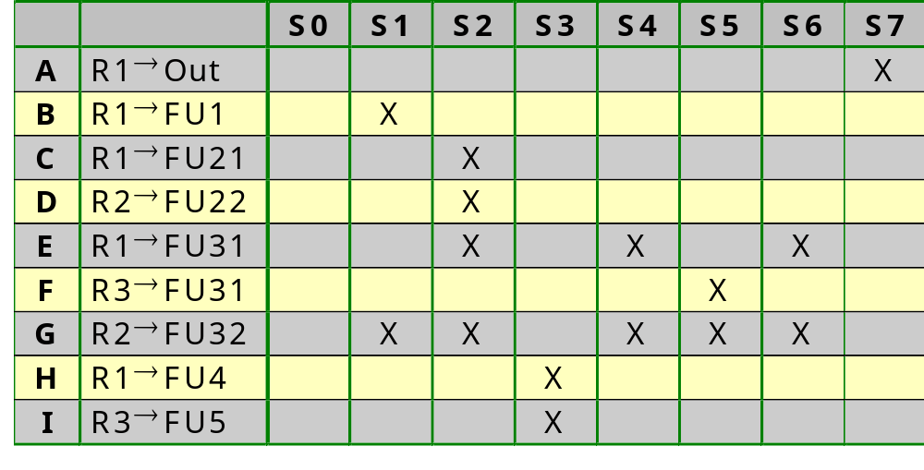
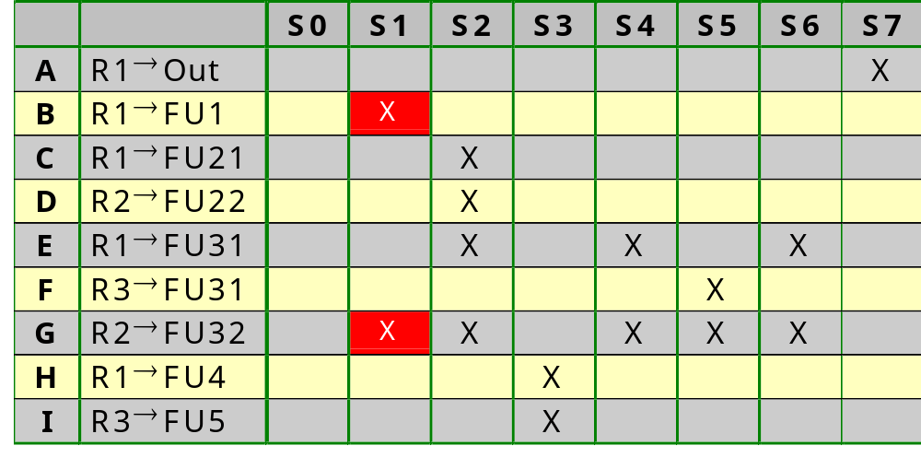
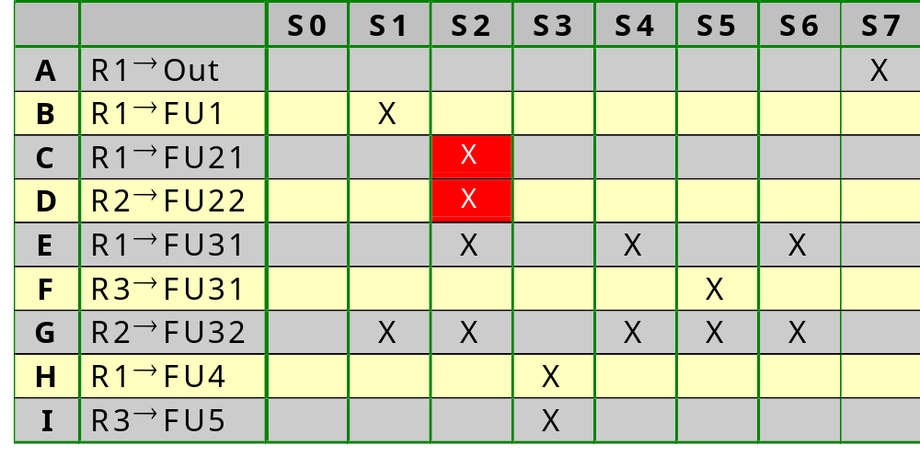
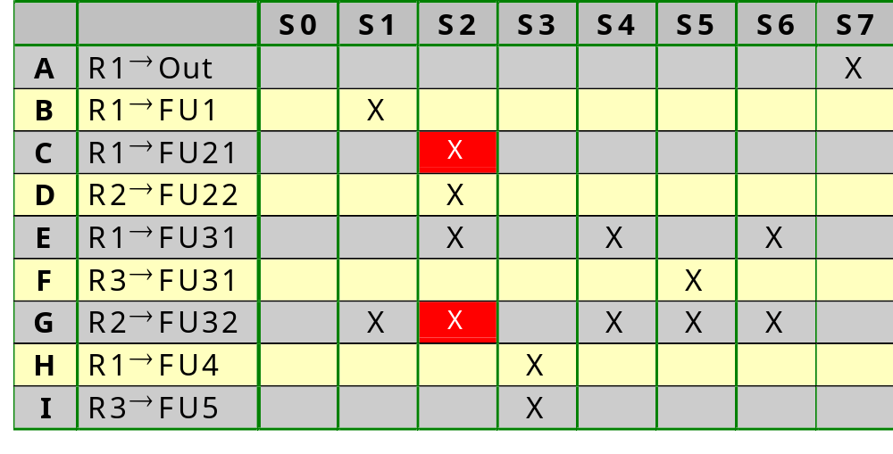






Bus sharing
B-G
C-D
C-G
D-E
E-G
H-I
F-G
R1=In1
R2=In2
0
Start
Out=R1
1
R1=F1(R1)
R2=F3(R2)
R1=F3(R1,R2)
Incompatible connections
are those that are used
in the same state and
come from a different
register
R1=F3(R1,R2)
R3=F2(R1,R2)
R2=F3(R3,R2)
R2=F4(R1)
R3=F5(R3)
R2=F3(R1,R2)

Slide 159
Bus sharing
Incompatibility edges:
B-G
C-D
C-G
D-E
A
E-G
H-I
I
B
F-G
H
C
G
D
F
E

Slide 160














Bus sharing
Priority edges:
same source or
same destination
A
I
B
H
C
G
D
F
E

Slide 161
Bus sharing
Bus 1: A, B, C, E, F, H
Bus 2: D, G, I
A
A
I
I
B
B
H
H
C
C
G
G
D
D
F
F
E
E

Slide 162
Bus sharing
In1
In2
A
B
C
D
E
F
G
H
MUX
MUX
MUX
R1: a,t1,x,t7
R2: b,t2,t3
t5,t6
R3: y,t4
FU1
FU2
FU3
FU4
FU5
Out
Name all input connections for the registers

Slide 163
Bus sharing
Build the compatibility graph: nodes are connections
A
H
B
G
C
F
D
E

Slide 164

Bus sharing
In which state is each connection used? From which source and to which destination do they go?

Slide 165





Bus sharing
A-D
B-E
C-G
F-H
R1=In1
R2=In2
0
Start
Out=R1
1
R1=F1(R1)
R2=F3(R2)
R1=F3(R1,R2)
Incompatible connections
are those that are used
in the same state and
come from a different
functional unit
R1=F3(R1,R2)
R3=F2(R1,R2)
R2=F3(R3,R2)
R2=F4(R1)
R3=F5(R3)
R2=F3(R1,R2)

Slide 166
Bus sharing
Incompatibility edges:
A-D
B-E
C-G
A
F-H
H
B
G
C
F
D
E

Slide 167









Bus sharing
Priority edges:
A
H
B
G
C
F
D
E

Slide 168
Bus sharing
Bus 1: A, B, C, H
Bus 2: D, E, F, G
A
A
H
H
B
B
G
G
C
C
F
F
D
D
E
E

Slide 169
Bus sharing
In1
In2
MUX
MUX
MUX
R1: a,t1,x,t7
R2: b,t2,t3
t5,t6
R3: y,t4
FU1
FU2
FU3
FU4
FU5
Out

Slide 170
Bus sharing
Cost calculation
  Register cost
    Before bus sharing: 2 3-to-1 MUXes and 1 2-to-1 MUX
    After bus sharing: 3 2-to-1 MUXes and 4 tri-state drivers
  Functional Unit cost
    Before bus sharing: 1 2-to-1 MUX
    After bus sharing: 6 tri-state drivers

Slide 171
Bus sharing
Cost of a tri-state driver
  FPGA
    each CLB has a tri-state driver to a horizontal long line
    cost is hence included in the CLB
    long lines are scarce: highest priority is reducing the number of connections

Slide 172
Bus sharing
Cost of a tri-state driver
  Gate array & CMOS
V_{cc}
E
I
F is driven high when
E=1 and I =1
F
E
I
F is driven low when
E=1 and I =0
V_{ss}
4 gates, 12 TOR

Slide 173
Bus sharing
Recalculation of register cost
  Cost of tri-state driver
    0 CLB
    4 gates
    12 TOR
  Cost of 1-bit 2-to-1 MUX
    1/2 CLB
    3 gates
    14 TOR
  Cost of 1-bit register
    1/2 CLB
    7 gates
    34 TOR
Recalculation of functional unit cost
  One 2-to-1 MUX less
  6 tri-state drivers more

Slide 174
Bus sharing
Register cost computation for current FSMD implementation:
  3 registers of 32 bits with 2-to-1 MUX; each register costs:
    0.5 CLB/MUXREGbit * 32 bit = 16 CLB
    (3 gates/MUXbit + 7 gates/REGbit) * 32 bit = 320 gates
    (14 TOR/MUXbit + 34 TOR/REGbit) * 32 bit = 1536 TOR
  4 tri-state drivers of 32 bits; each tri-state driver costs:
    0 CLB/TRIStatebit * 32 bit = 0 CLB
    4 gates/TRIStatebit * 32 bit = 128 gates
    12 TOR/TRIStatebit * 32 bit = 384 TOR

Slide 175

Functional-unit sharing
Note that bus sharing also influenced the cost
of registers as well as FUs: all 4 minimization
steps influence each other.
We could have made estimates of this influence and used
this for guiding the register and FU sharing

Slide 176
FSMD design
FSMDs
Models
Synthesis techniques
  Basic principles
  Merging
    Register sharing (variable merging)
    Functional-unit sharing (operator merging)
    Bus sharing (connection merging)
    Register port sharing (register merging)

Slide 177
Register port sharing
Basic principle:
  Combine several registers into one register file to reduce the number of read ports (less input MUXes) and the number of write ports (less tri-state drivers
Methodology: build the Register Access Table, indicating reads and writes to registers in each state

Slide 178


Register port sharing
Reuse
Reg→FU
table
used for
connection
merging

Slide 179


Register port sharing
Reuse
FU→Reg
table
used for
connection
merging

Slide 180
Register port sharing
When implemented as three registers, we need 3 write ports and 3 read ports
In next slides, we do an exhaustive search (i.e. we enumerate all possibilities and compute their cost) for merging 2 or more registers in 1 register file
For large designs, we would need an optimization technique

Slide 181
Register port sharing
How many ports are needed for a register file sharing 2 registers?
  Combine R1 and R2
    2 read ports (S1, S2, S4, S6)
    2 write ports (S0, S1)
  Combine R1 and R3
    2 read ports (S3)
    2 write ports (S2)
  Combine R2 and R3
    2 read ports (S5)
    2 write ports (S3)
  No saving is obtained

Slide 182
Register port sharing
How many ports are needed for a register file sharing 3 registers?
  Combine R1, R2 and R3
    2 read ports (S1, S2, S3, S4, S5, S6)
    2 write ports (S0, S1, S2, S3)
  We save 2 ports

Slide 183
Register port sharing
In1
In2
R1: a,t1,x,t7
R2: b,t2,t3
t5,t6
R3: y,t4
FU1
FU2
FU3
FU4
FU5
Out

Slide 184
Register port sharing
Recalculation of register cost
  Before register port sharing: 3 2-to-1 MUXes and 4 tri-state drivers
  After register port sharing: 4 tri-state drivers
  Saving:
    0 CLB (the small MUXes fitted in the same CLB as the register bits)
    3 gates/MUXbit * 32 bit = 96 gates
    14 TOR/MUXbit * 32 bit = 448 TOR

Slide 185

Register port sharing

